Slide 1
Getting Started

Slide 2
Getting Started Part 2
RA Tool should be released in next few weeks
One LA contact will be set up and sent link
Contact can set up other users within LA
May be period to allow users to “play” with system
2 levels of access
Interrogator (read only)
Risk assessor (read / write)
Helpful if LAs can decide what they need initially and apply at same time
Future users can be added after as needed

Slide 3
Loading data
Opportunity to load “bulk” data to get started
DWQR will load basic supply registration details from 2018 return
Sources, Tanks, Properties data can be loaded using 3 separate spreadsheets
One line for each asset
Must be in correct format, but can leave blanks
Process is not compulsory!
Once only opportunity

Slide 4
User Account Management
DWQR Risk Assessment Training 2018

Slide 5
Overview
Users need own account to access system (username / password)
Accounts managed by DWQR
No limit on number of accounts
Process for users to reset own password
Account Types
(LA) Risk Assessor – read and edit
(LA) Interrogator – read only
(DWQR) Admin
(DWQR) Super Admin – can edit lists etc

Slide 6
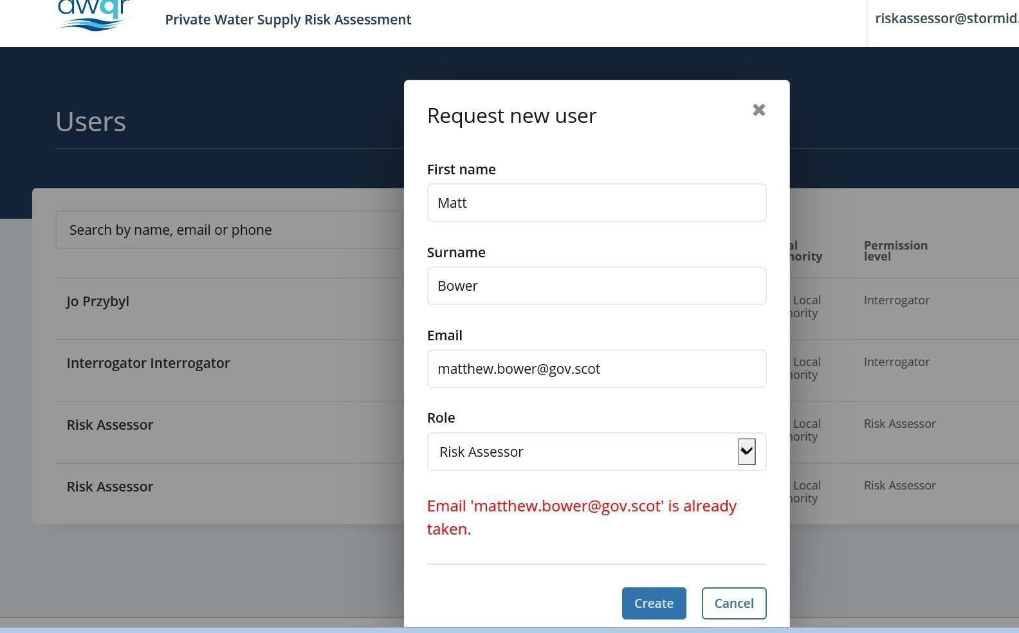
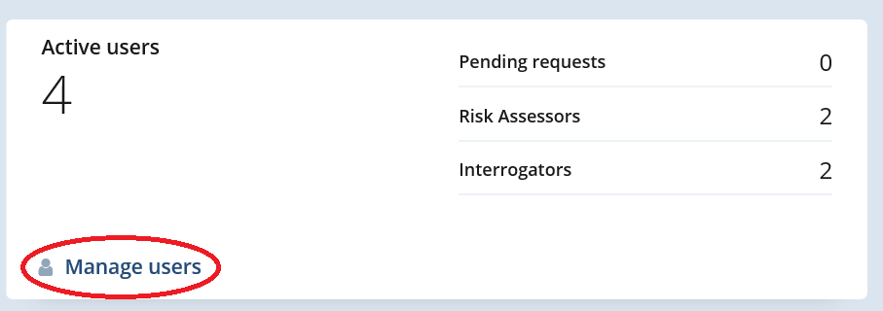
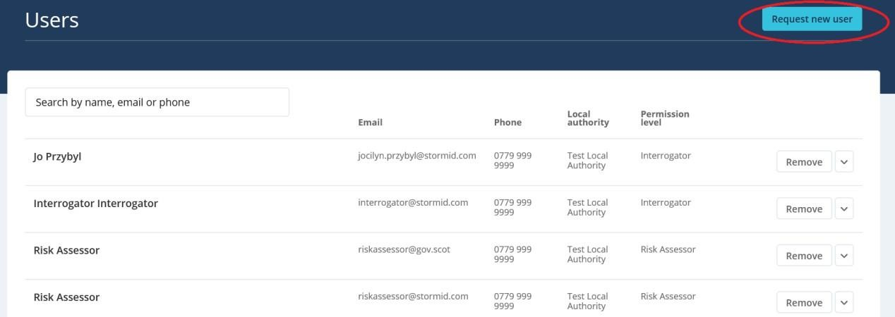
How do I set up an account?

Slide 7
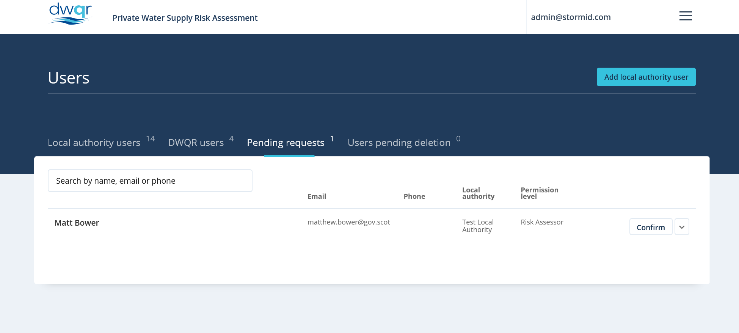
How do I set up an account? Part 2

Slide 8
Problems?
Please try to email us in first instance
Plan ahead – what are you going to need?
Email DWQR@gov.scot
We’ll try to respond within a few days
Desperate?
Telephone 0131 244 0190
We’ll try to assist, but we don’t have a call centre!

Slide 9
Ongoing Support
System fairly intuitive – no large manual required!
Slides from training days plus notes will be published on DWQR website as guidance / manual for key operations
If stuck email DWQR DWQR@gov.scot and we will try to assist (put RA tool in header)
Individual council visits possible, other work permitting
Subgroup have set up RIAMS forum for Scottish LAs

Slide 10
DWQR Expectations
New RA tool will start to be used
Phased, not Big Bang
Detailed implementation up to LA
Expect every LAs to have some RAs on system by year end
Registration
Should aim to have all Regulated supplies registered by end year
All details (esp. property element) to be refined over time
LA decision whether to register Exempt supplies
Drinking Water Safety Plans
DWQR hopes they will be used to drive improvements
Not compulsory - up to LA / individual situation

Slide 11
The future….
Progress will be reviewed by DWQR / PWS subgroup
Feedback via DWQR / Subgroup or Forum
Probable Seminar in Spring

Slide 12
Overview
Matt Bower
DWQR Risk Assessment Training 2018

Slide 13
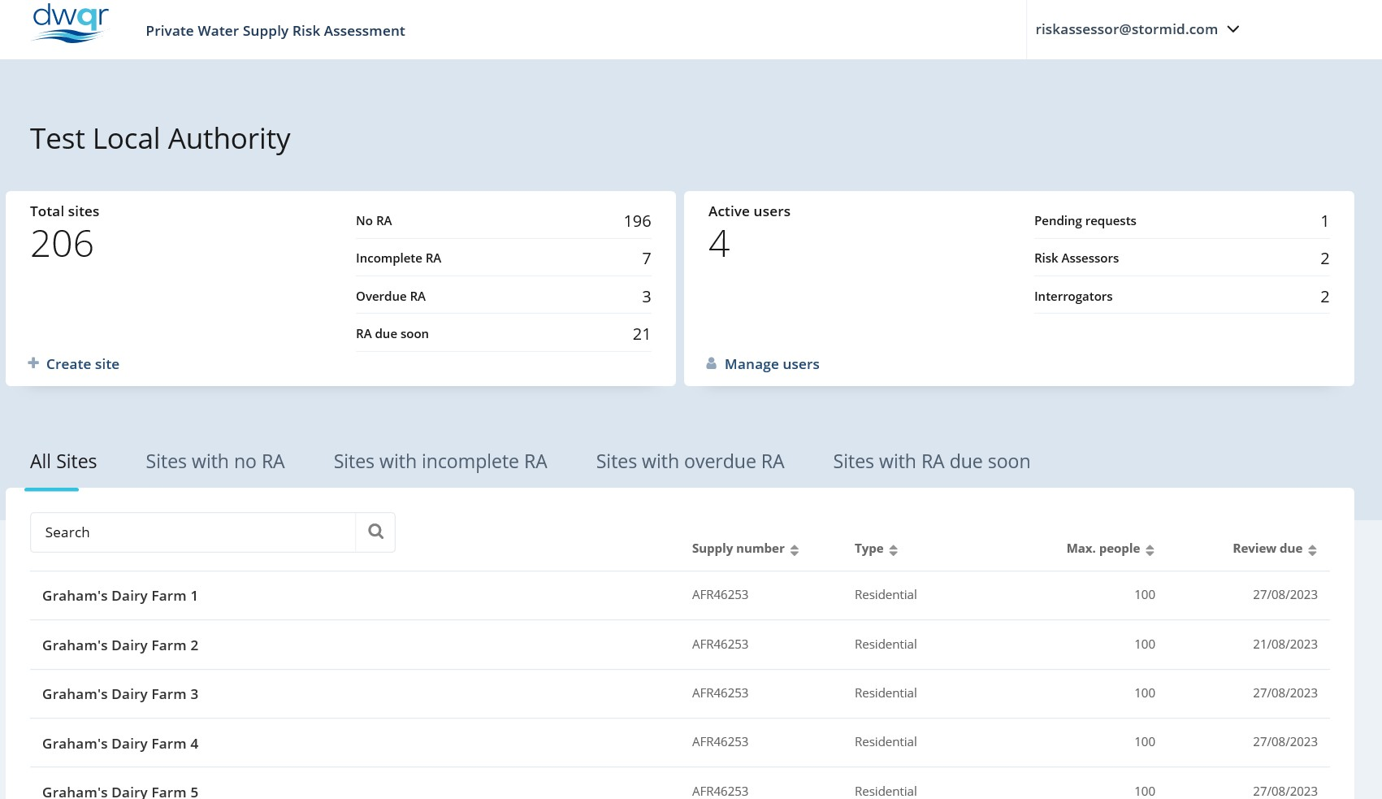
Overview of RA Tool
Designed to be:
Intuitive
Flexible
Comprehensive (Where it needs to be)
Compliant with Regulations
Useful

Slide 14
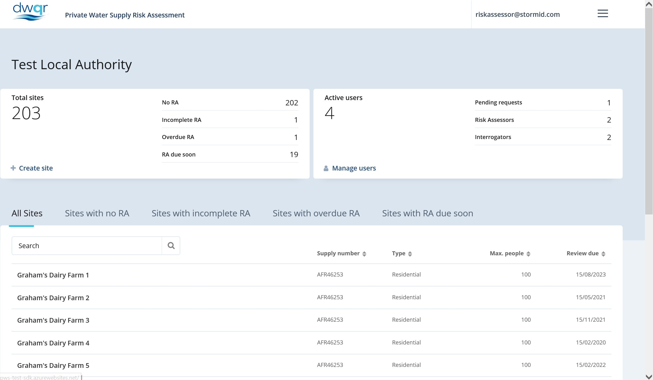
LA Dashboard

Slide 15
LA Dashboard Part 2

Slide 16
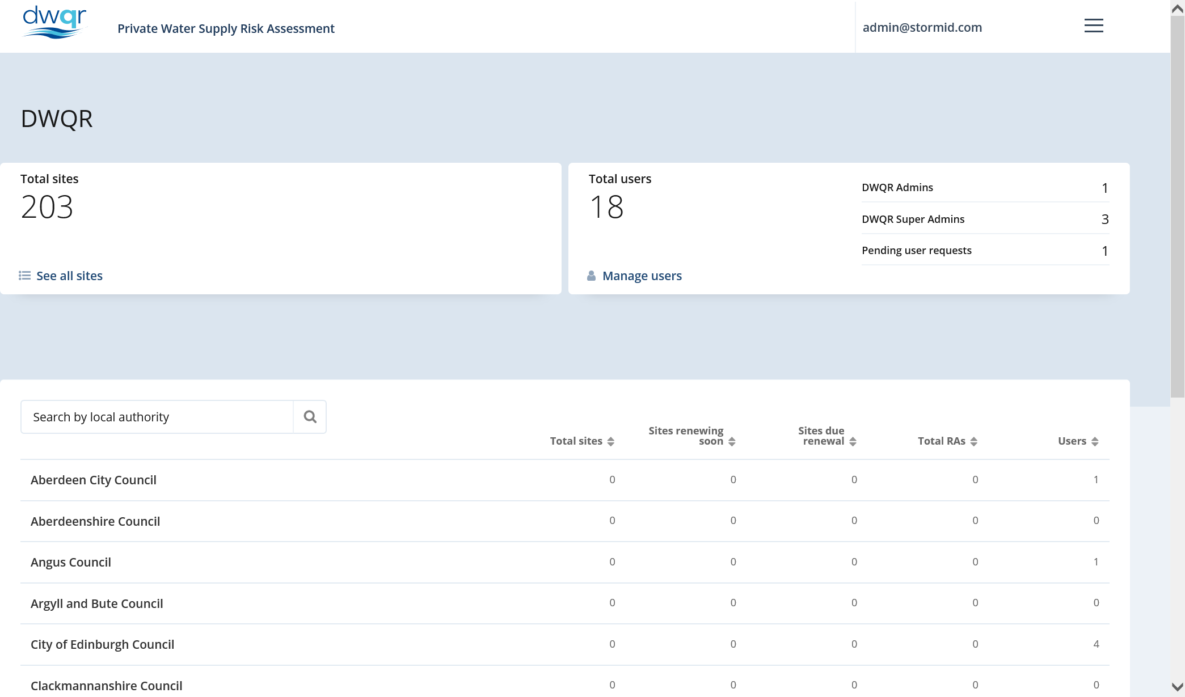
DWQR Dashboard

Slide 17
Registering Sites
Matt Bower
DWQR Risk Assessment Training 2018

Slide 18
Overview of RA Tool Register

Slide 19
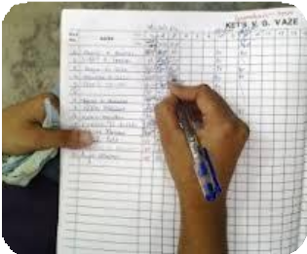
Overview Part 2
Need to register sites in order to risk assess
Risk assessment pulls through register info
Registration ensures compliance with Reg.5
Except – Ownership (GDPR issues), Monitoring & sample results
May be an iterative process – e.g. properties
System saves as you go
Scope to ease burden of DWQR return

Slide 20
Overview of RA Tool Register Part 1
Add as many sources, tanks, properties as you need – this will structure RA
Select relevant treatment processes

Slide 21
Overview of RA Tool Register Part 2
Add as many sources, tanks, properties as you need – this will structure RA
Select relevant treatment processes
Don’t worry – you can make changes at any stage

Slide 22
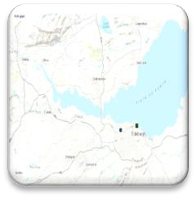
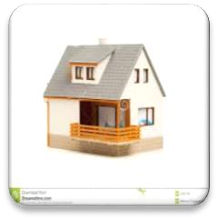
Overview of RA Tool Register Part 3
Mapping Tool
Plots Sources, Tanks, Props automatically based on info provided
Facility to draw pipes
Ability to attach documents
Photos
Letters
Spreadsheets
UPRN facility
Properties
Sources
Tanks
Treatment

Slide 23
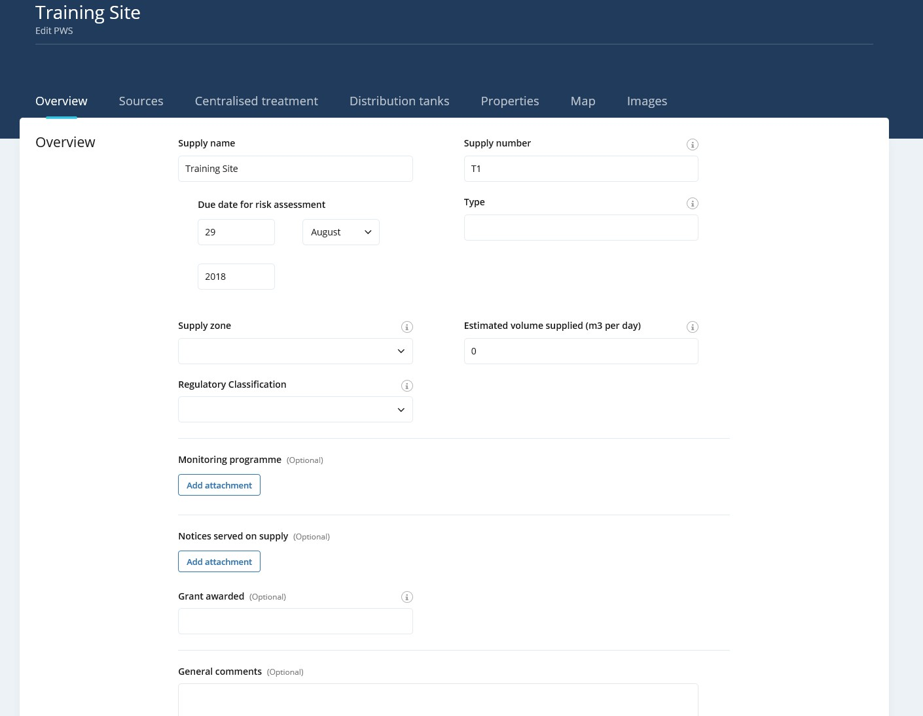
Overview Page
Number is your reference – no need to create anything special (System creates its own (hidden) ID)
Free text to describe the supply (should explain its classification)

Slide 24
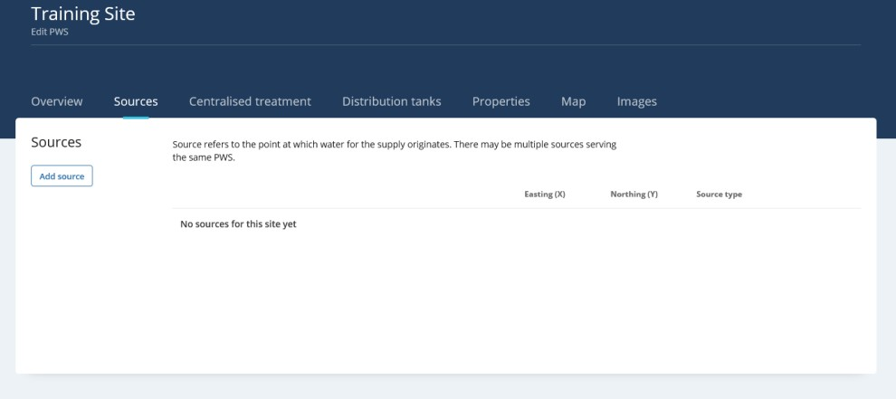
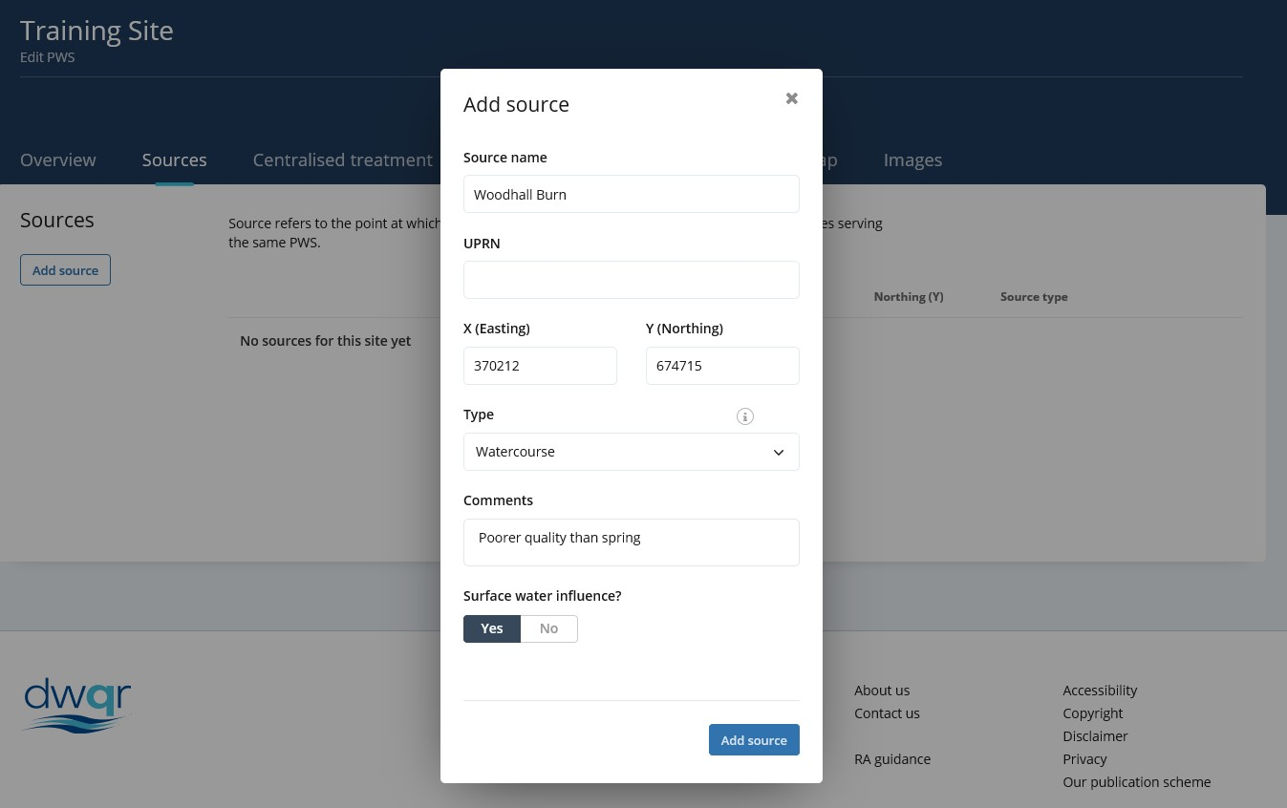
Registration - Sources
Click add source…
UPRN not compulsory
Standard drop down list of source
types (editable by DWQR)
Saves as you go, but just in case!

Slide 25
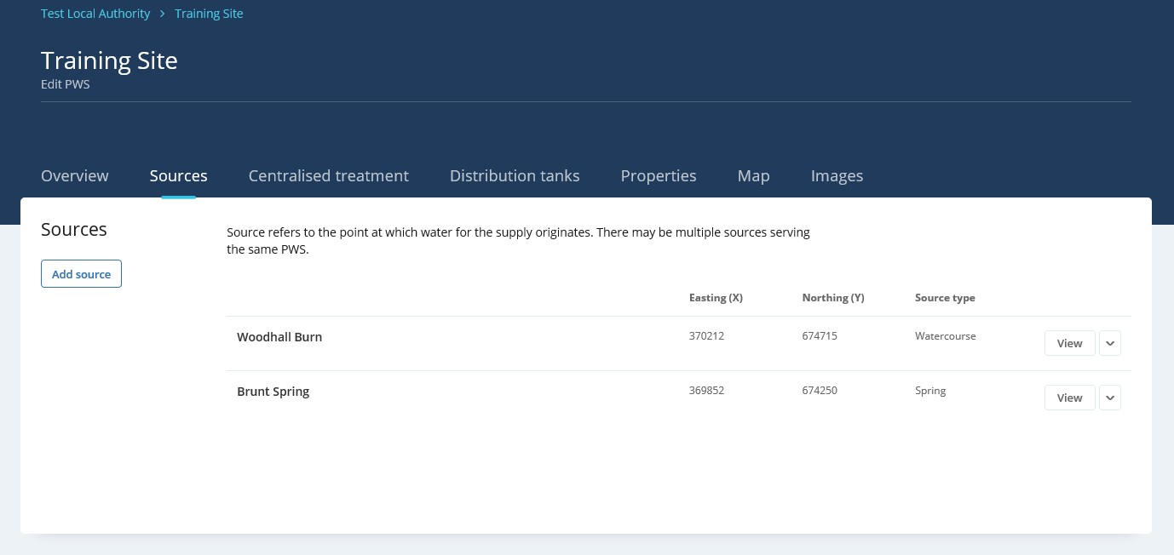
Registration – Sources Part 2
Sources appear here. As many as you need…..
Option to view or edit

Slide 26
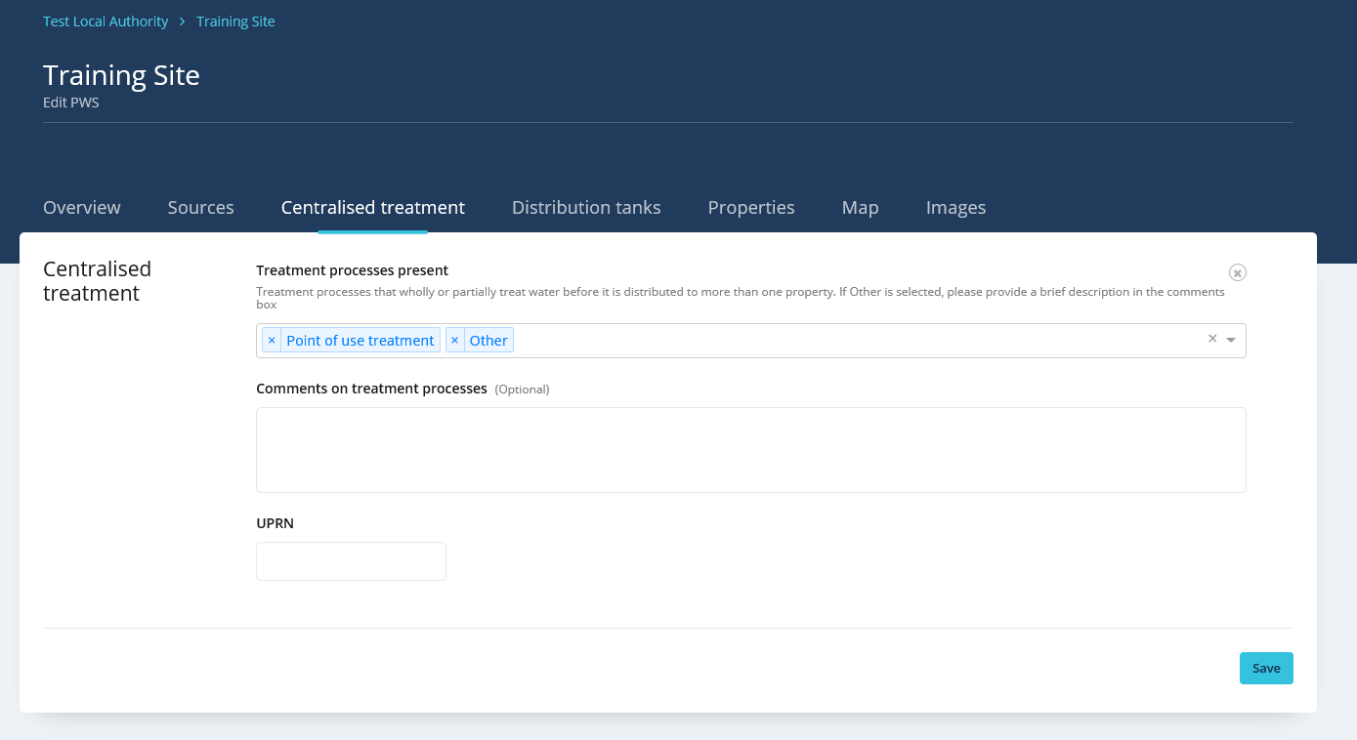
Registration – Centralised Treatment
Select relevant treatment processes. This will determine Risk Assessment structure.
Optional

Slide 27
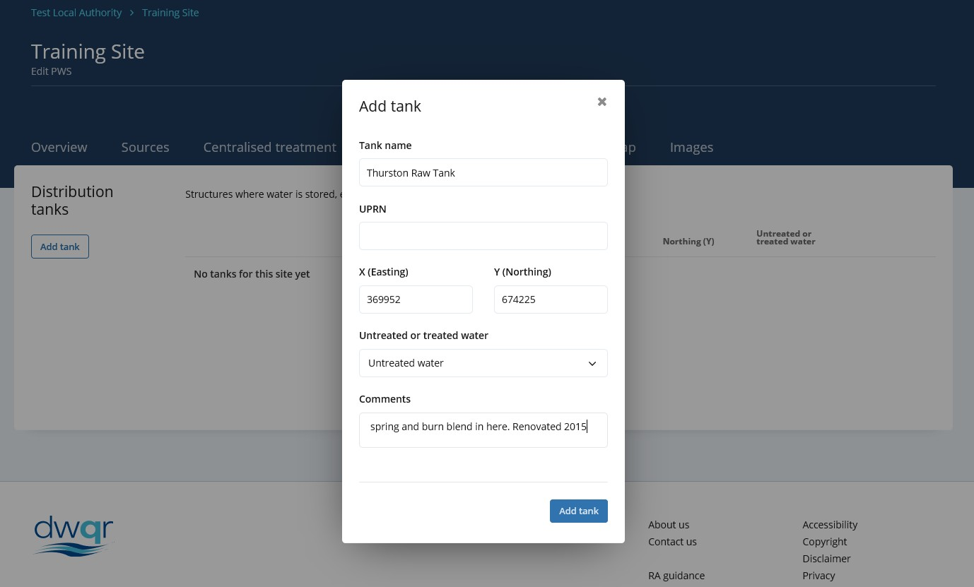
Registration - Tanks
Choose treated or untreated

Slide 28
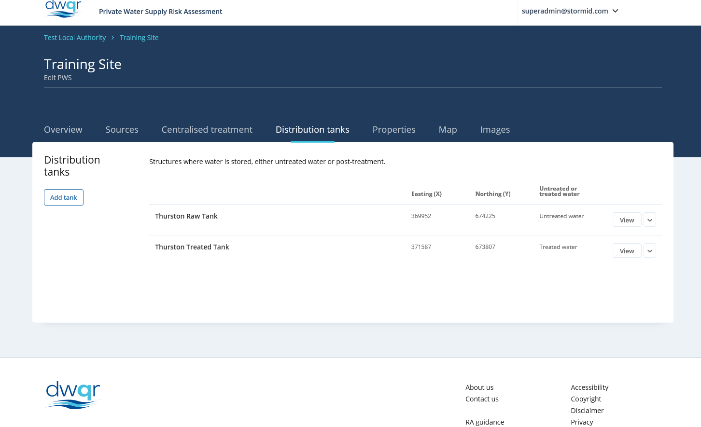
Registration – Tanks Part 2

Slide 29
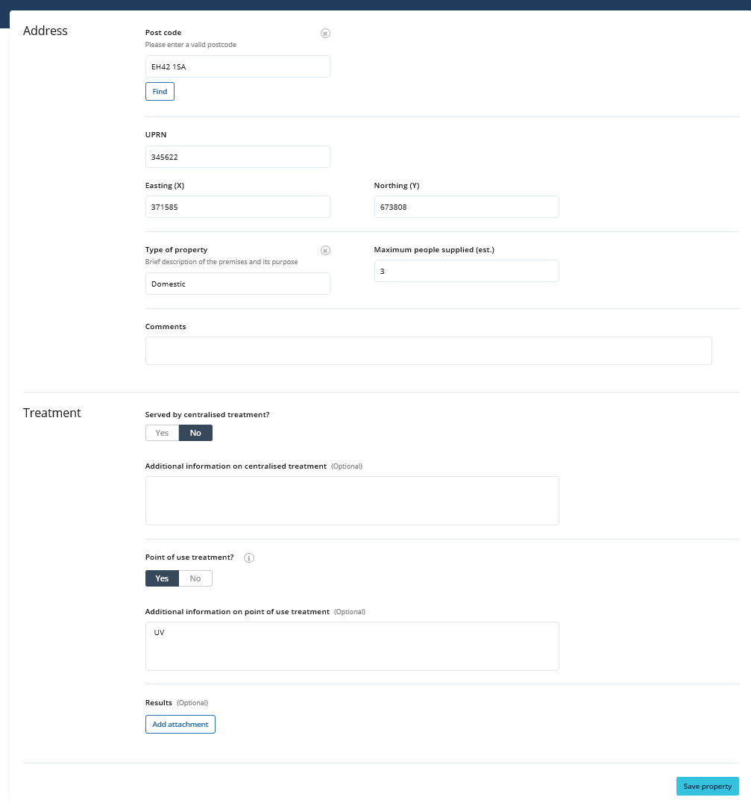
Registration - Properties
Gazetteer will find property
from postcode

Slide 30
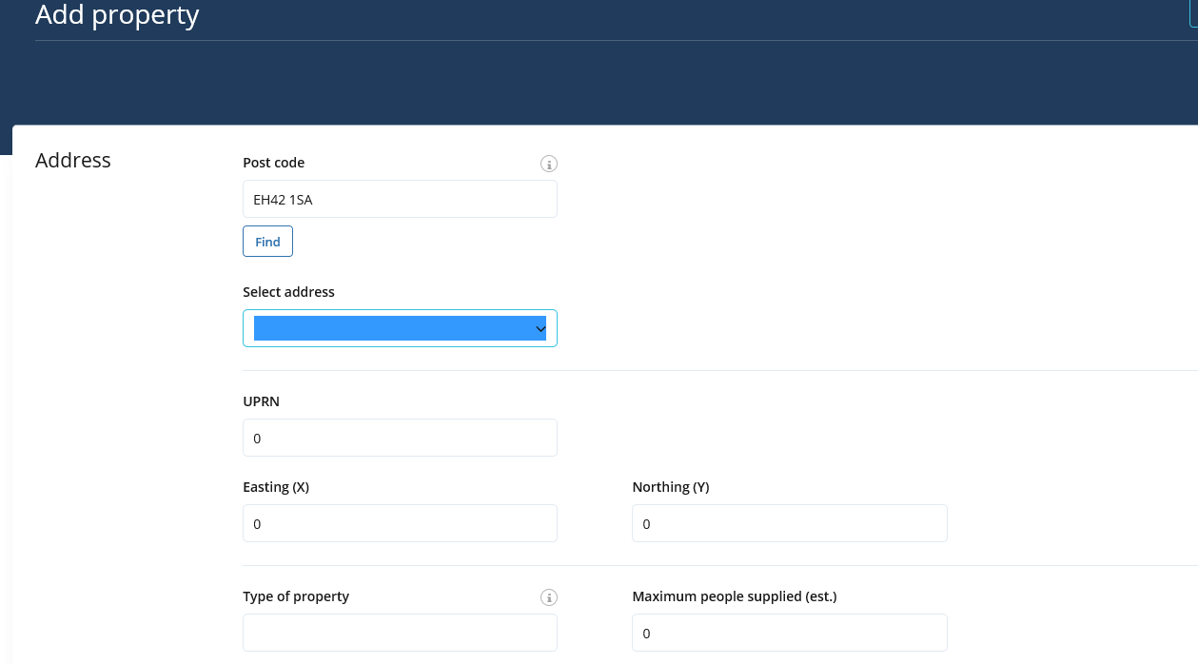
Registration – Properties Part 1
If more than one will give
drop down list of addresses

Slide 31
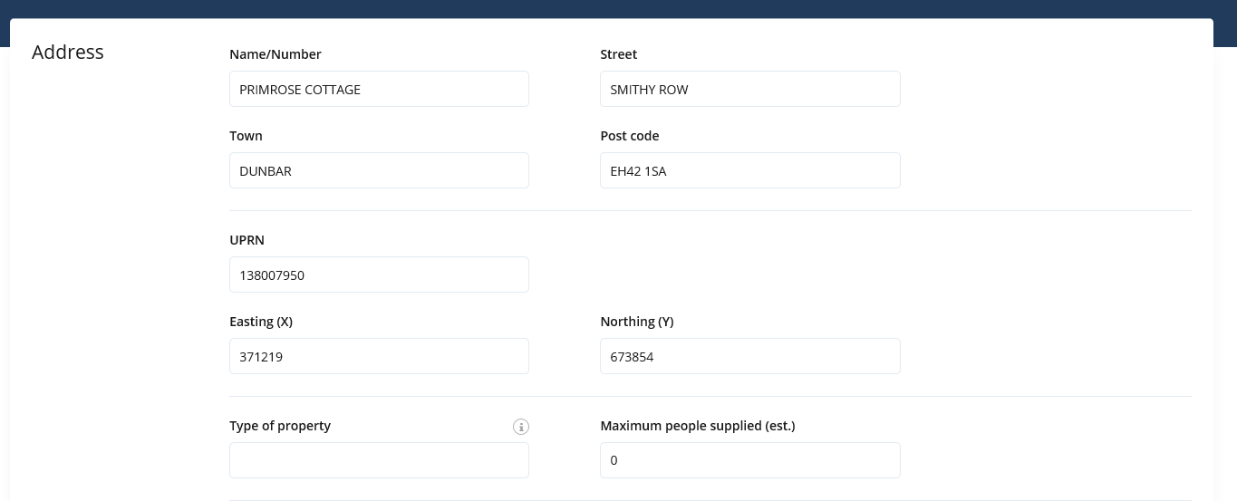
Registration – Properties Part 2
UPRN and Grid ref populate automatically

Slide 32
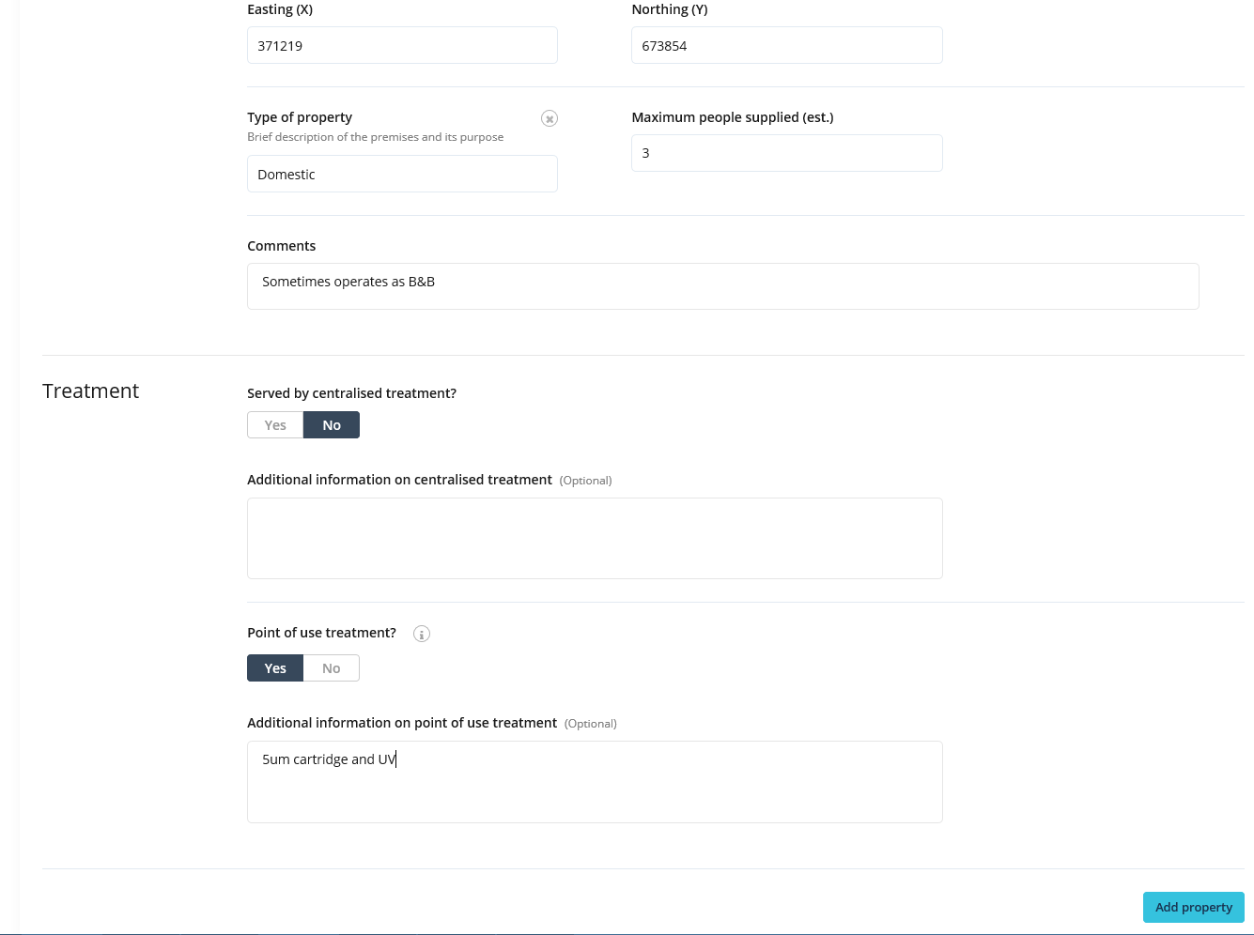
Registration – Properties Part 3
Complete other information as available. Plenty of free text comments fields.
Add property when finished

Slide 33
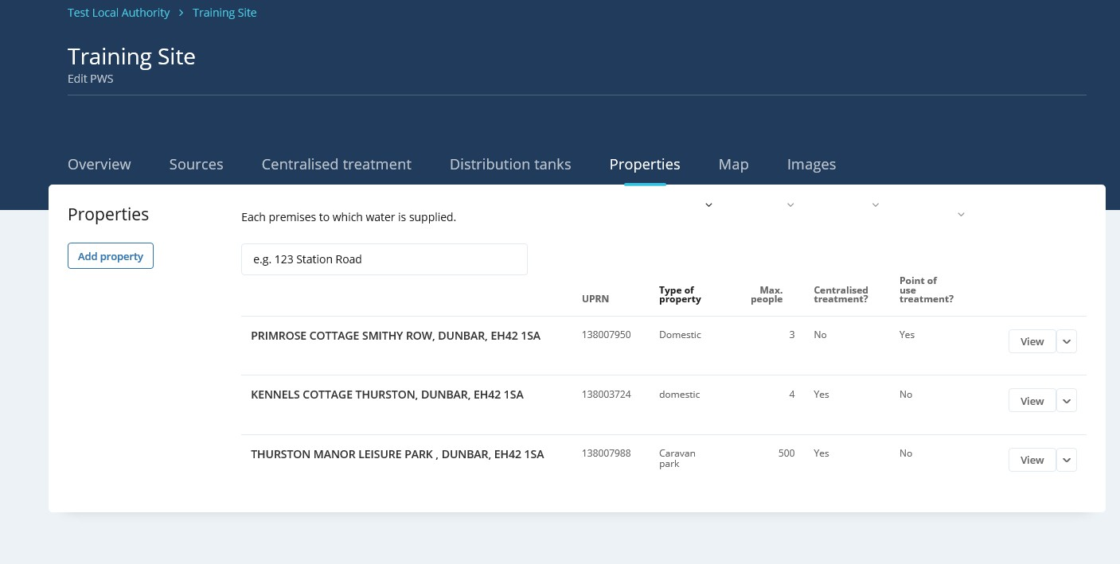
Registration – Properties Part 4
Add property when finished

Slide 34
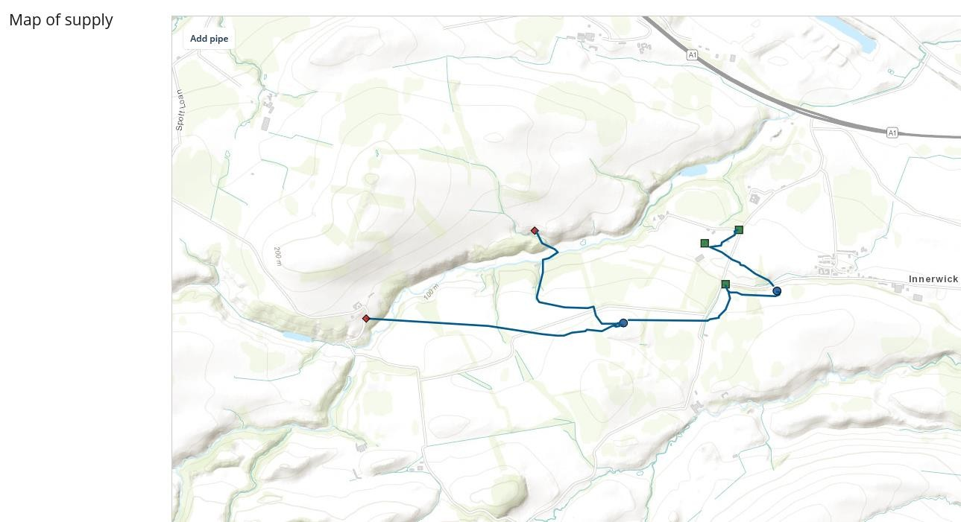
Registration – Mapping Tool
Can zoom in using mouse wheel. Facility to add pipes
Click to start drawing, double click
to stop.
Can click on pipe section afterwards to delete.
Practice makes perfect!!

Slide 35
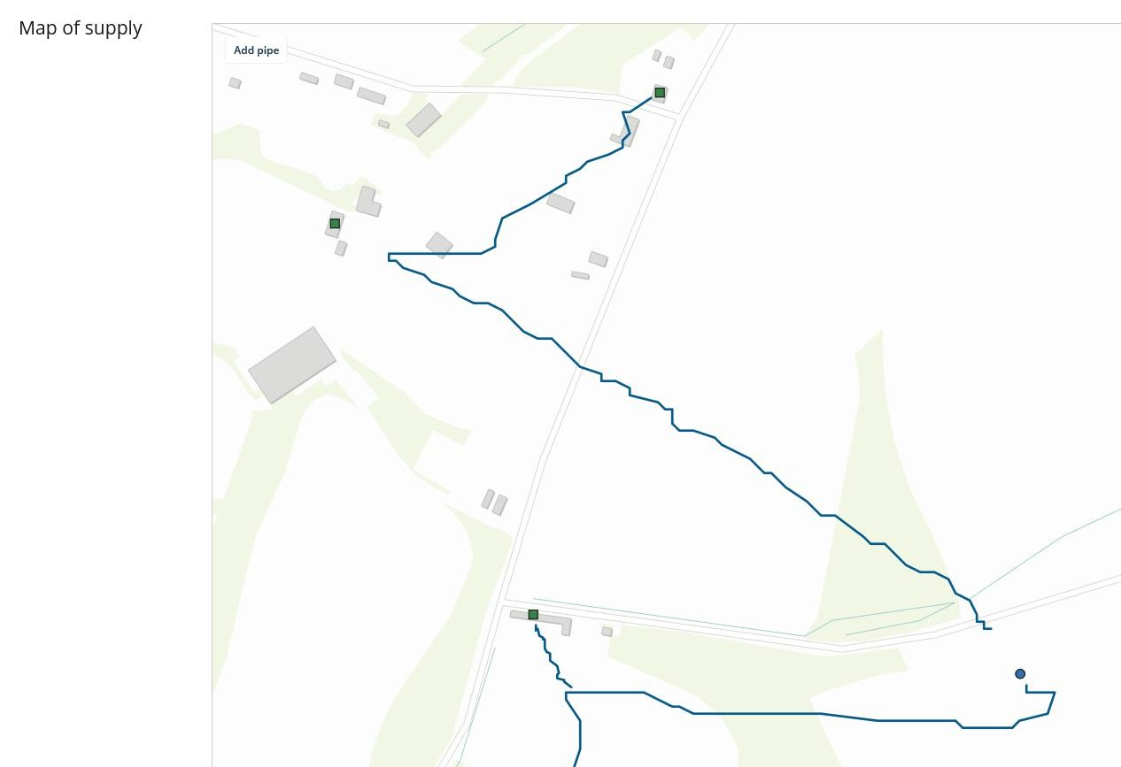
Registration – Mapping Tool Part 2

Slide 36
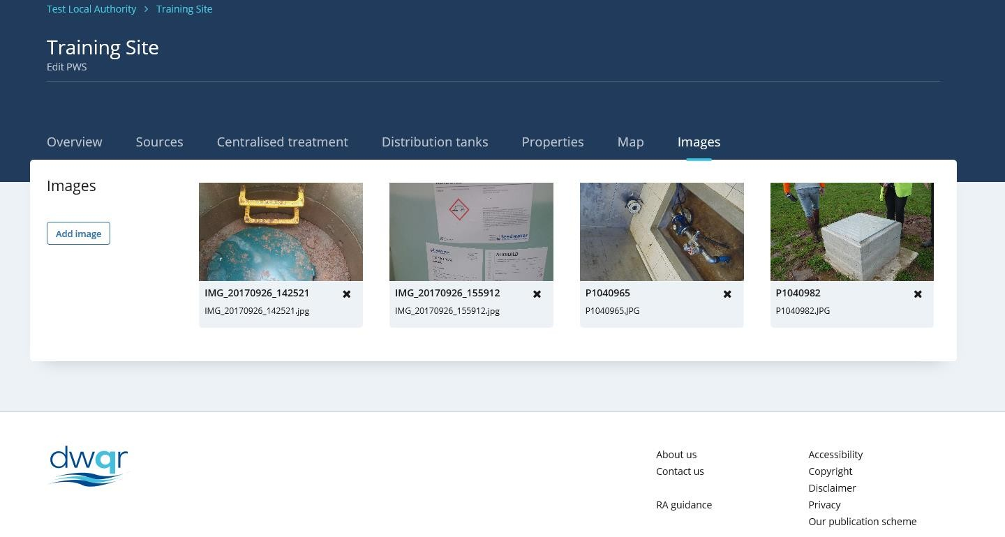
Registration – Images
Can browse for photos

Slide 37
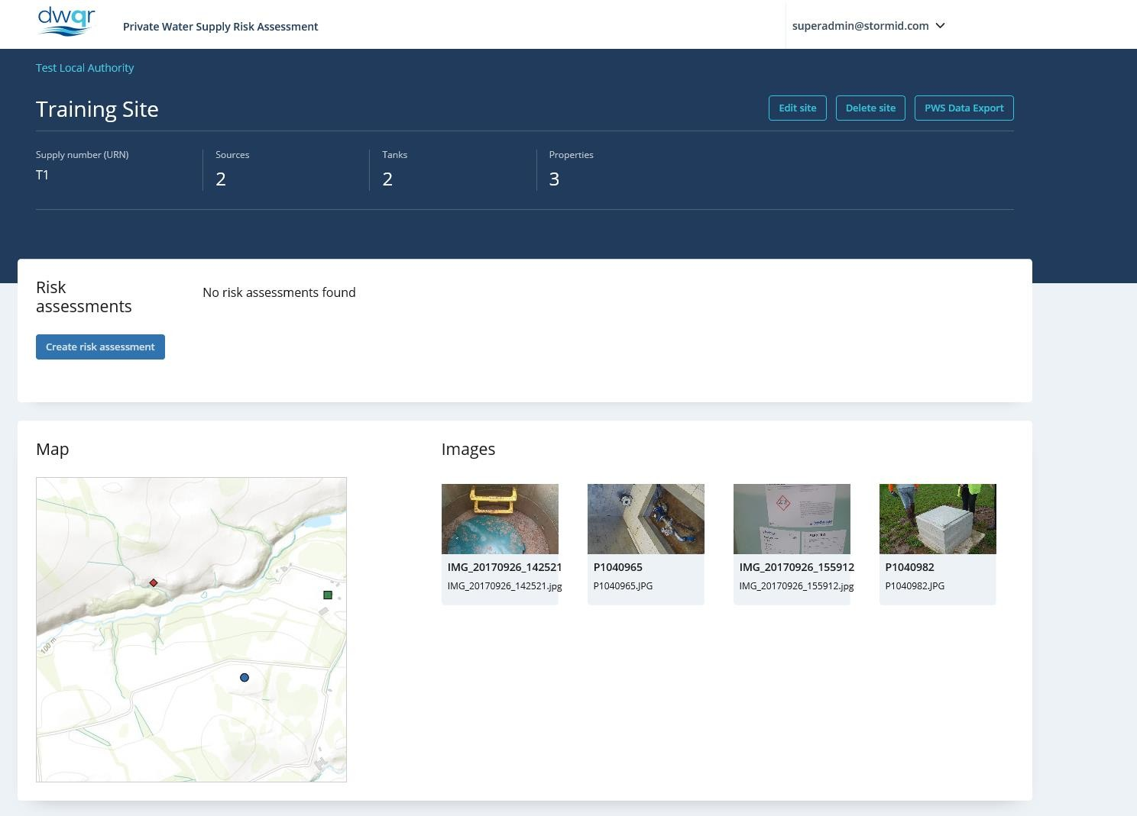
Registration – PWS Front Page
Front page for PWS now looks like this

Slide 38
Registration – PWS Front Page Part 1
Front page for PWS now looks like this

Slide 39
Registration – PWS Front Page Part 2
Local authority | Test Local Authority
Supply name | Training Site
Supply number | T1
What is the regulatory classification of the supply? | Regulated
Estimated volume supplied (m3 per day) | 50
Population | 507
Treatment processes present
Date last RA completed
Highest risk score
Highest mitigated risk score
Average mitigated risk score
Source name | Woodhall Burn
Source Easting (x) | 368635
Source Northing (y) | 673625
Source type | Watercourse
Source name | Brunt Spring
Source Easting (x) | 369852
Source Northing (y) | 674250
Source type | Spring
Tank name | Thurston Raw Tank
Tank Easting (x) | 370482
Tank Northing (y) | 673580
Treated or untreated water | Untreated water
Tank name | Thurston Treated Tank
Tank Easting (x) | 371587
Tank Northing (y) | 673807
Treated or untreated water | Treated water
Property name/number | PRIMROSE COTTAGE
UPRN | 138007950
Type of property | Domestic
Estimated max no. of persons supplied | 3
Served by centralised treatment? | No
Point of use treatment? | Yes
Property name/number | KENNELS COTTAGE
UPRN | 138003724
Type of property | domestic
Estimated max no. of persons supplied | 4
Served by centralised treatment? | Yes
Point of use treatment? | No
Property name/number | THURSTON MANOR LEISURE PARK
UPRN | 138007988
Type of property | Caravan park
Estimated max no. of persons supplied | 500
Served by centralised treatment? | Yes
Point of use treatment? | No

Slide 40
Source - General
Matt Bower
DWQR Risk Assessment Training 2018

Slide 41
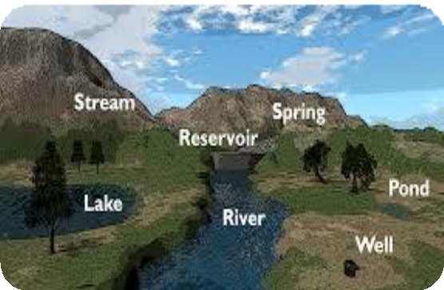
Overview Of Source
Source :
Anywhere the PWS originates from

Slide 42
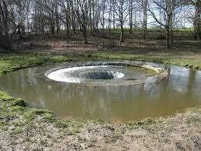
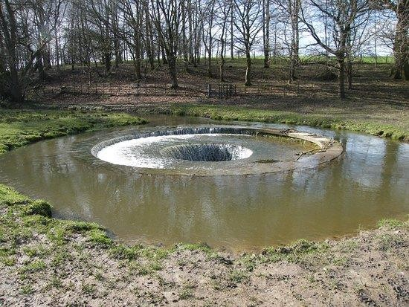
Overview of Source
Source :
Anywhere the PWS originates from
If someone’s drinking it, it needs to be risk assessed

Slide 43
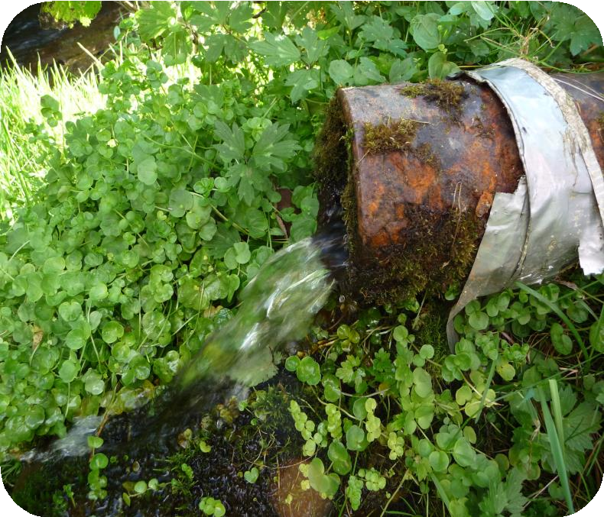
Biggest risk? Lack of knowledge
Overview

Slide 44
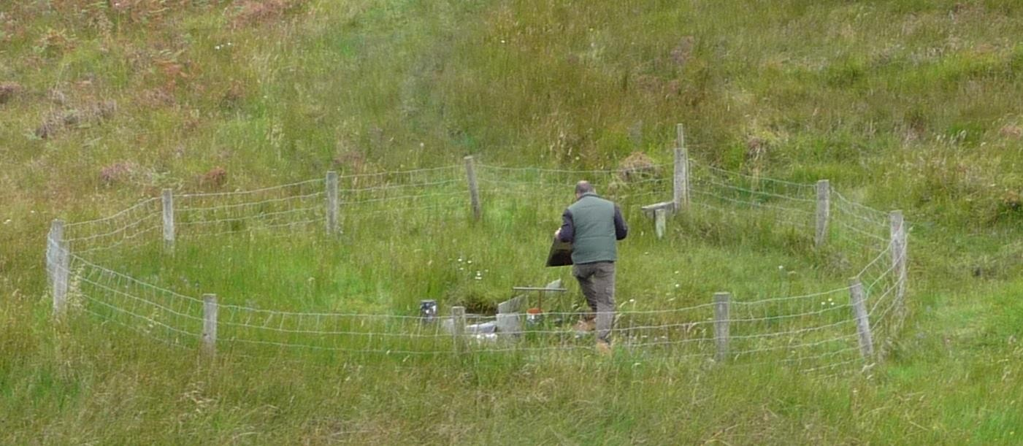
What are we risk assessing?

Slide 45
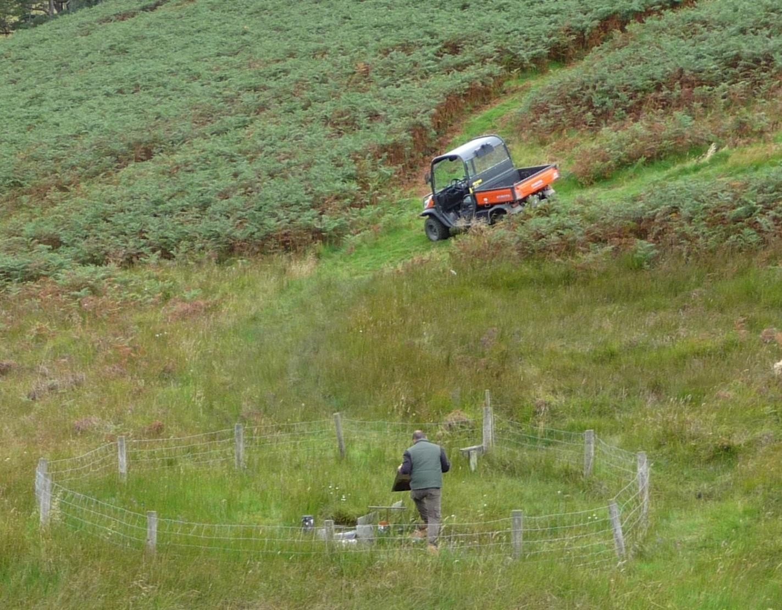
What are we risk assessing? Part 1

Slide 46
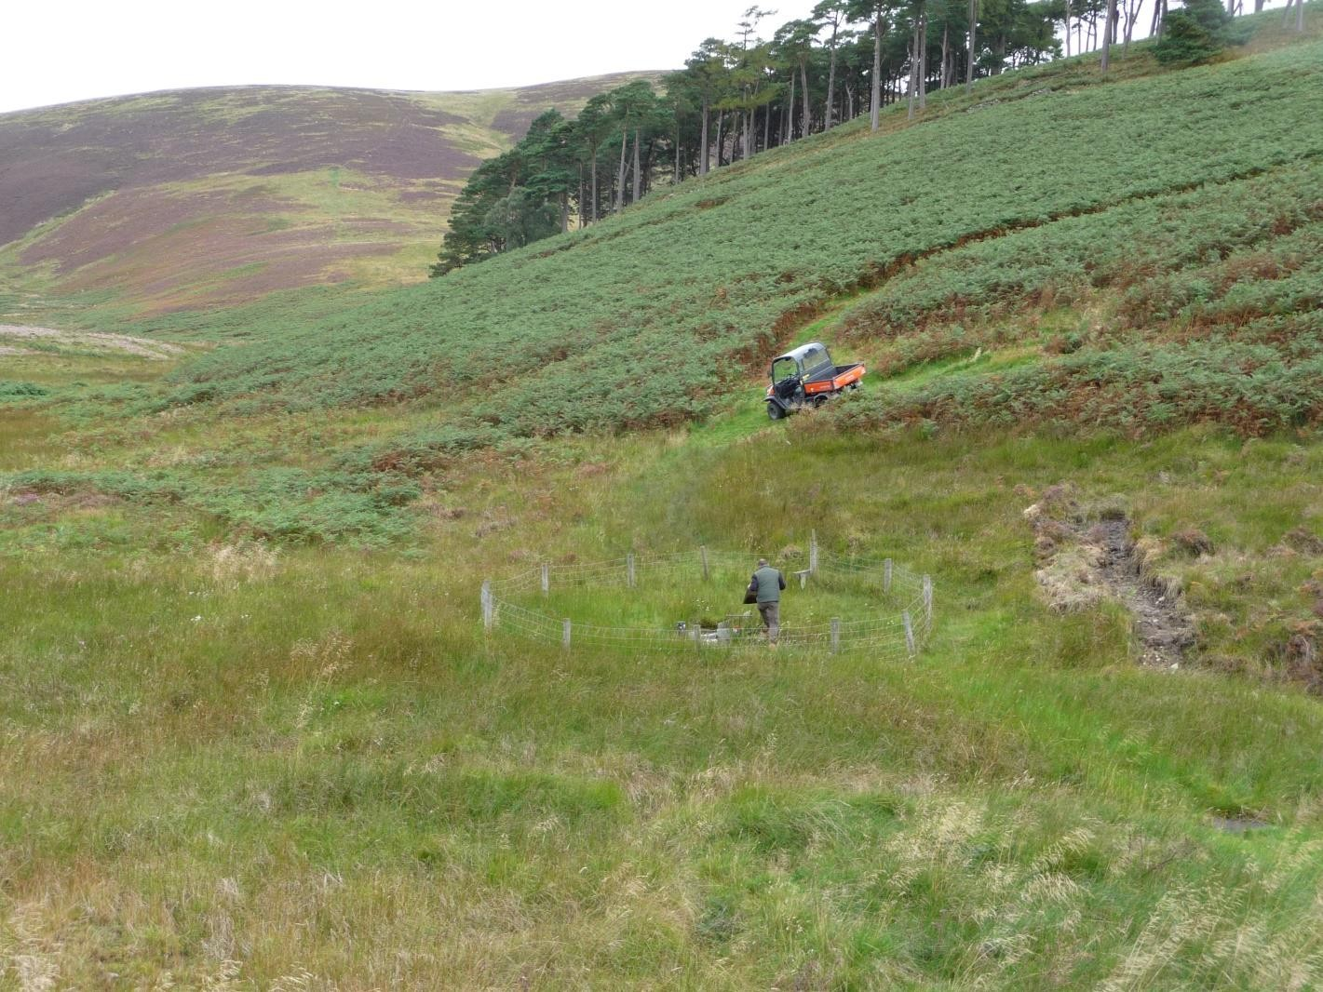
What are we risk assessing? Part 2

Slide 47
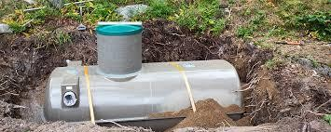
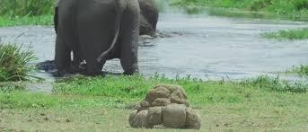
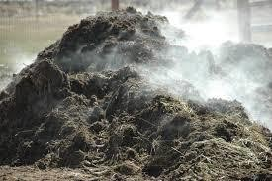
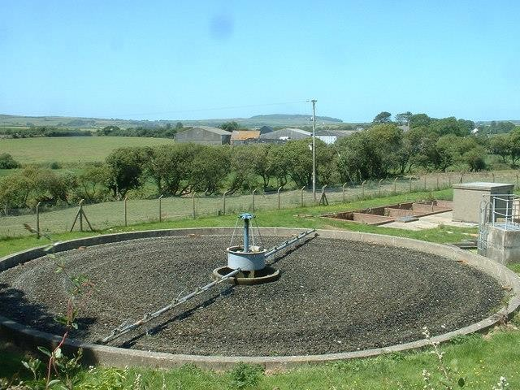
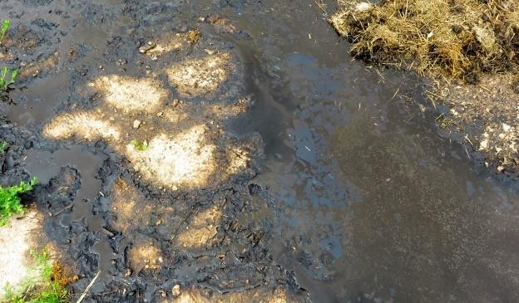
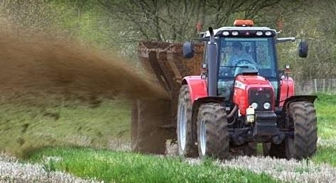
What sort of risks?

Slide 48
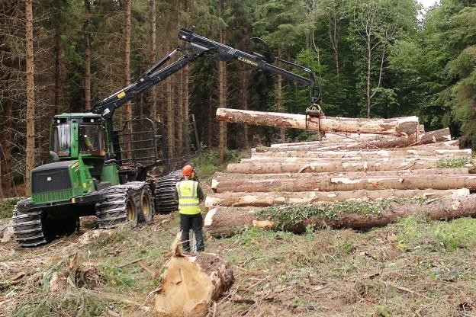
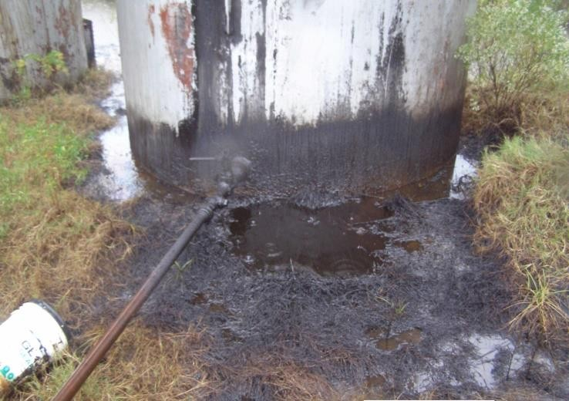
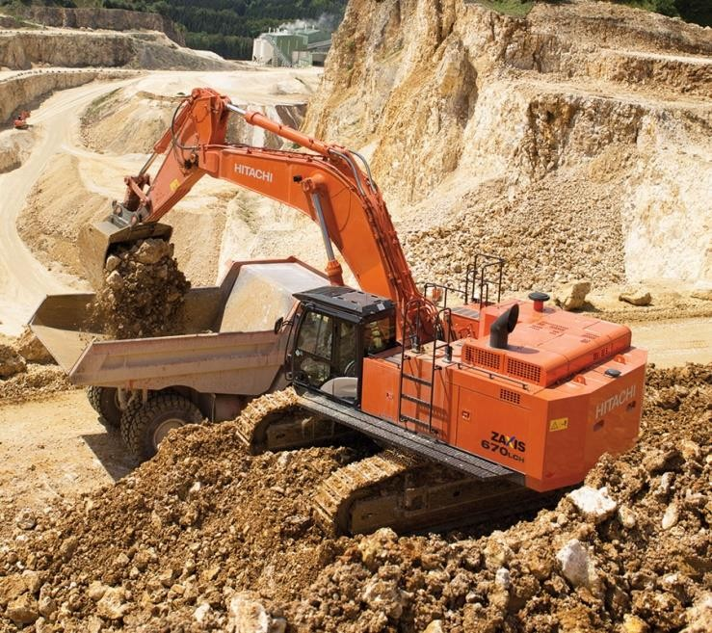
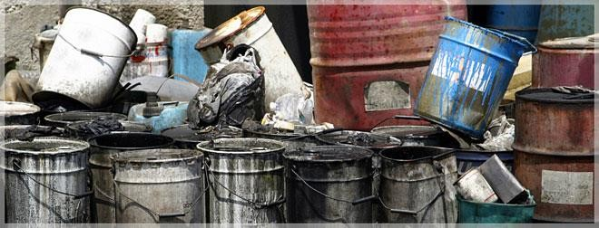
What else?
Manmade Issues

Slide 49
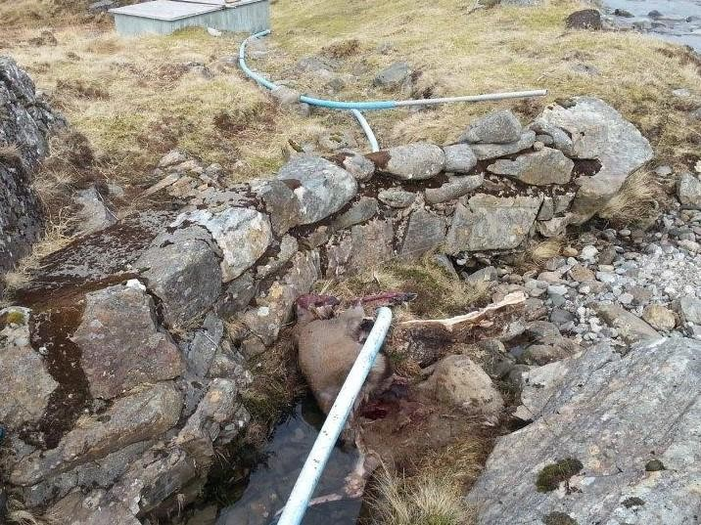
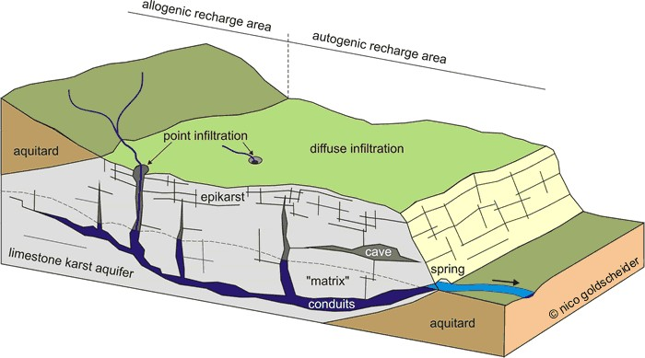
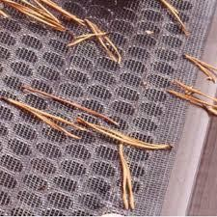
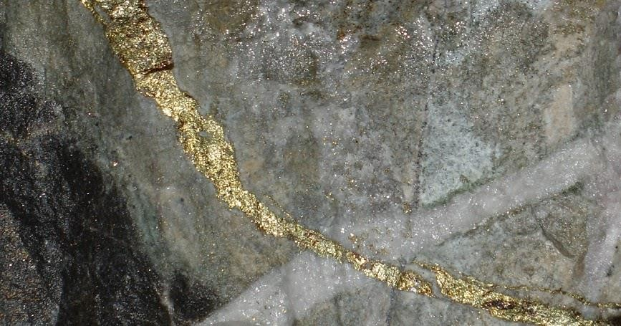
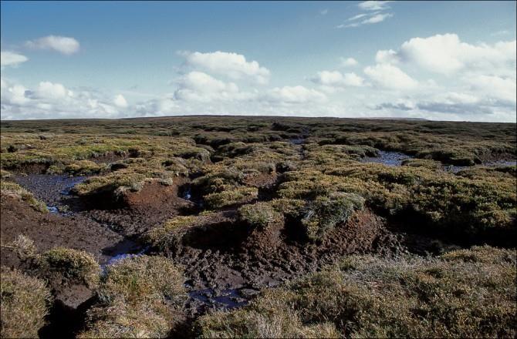
What else?
Natural Issues

Slide 50
Questions
SG1 | Is there a lack of knowledge and understanding about the source of the supply? | The origin/location of the water source(s) should be known. A site plan or schematic should be available, this can be a simple sketch or a more complex and detailed drawing depending on the size of the supply. It need not be to scale but should represent the main source(s) of the supply. It is essential to have a knowledge of the source(s) so that any contamination risks can be identified and appropriate mitigation action taken. If location or understanding of the source of the supply is not present then the risk assessment of the source is difficult if not impossible to achieve. If not present, the likelihood should be scored as 5 and the person in control should be asked to make arrangements to determine the source and provide a map of the source as part of the action plan. | 5
SG2 | Is there a risk of faecal contamination of the source from activities in the catchment? | The active application of slurry/dung is a hazard in conjunction with the disruption of the soil itself, e.g. via ploughing or sub-soil injection. The likelihood value will be based on the probable duration and frequency at which such activities are undertaken. In some areas brownfield sites or derelict land will be remediated using sewage-derived sludge or slurry or similar materials. The rate of application will typically be higher and this should be borne in mind when assessing the risk. The presence of livestock close to the source has the potential to lead to microbiological contamination of the source. Consider periods for which animals are present, the time of year they are present, density of livestock, and closeness to the source. New sources should not be installed within 50m of unsewered human or animal waste in high vulnerability areas. | 5
SG3 | Is there a risk of faecal contamination of the source from storage or distribution of sewage/waste? | If unsewered human or animal sanitation facilities (e.g. latrines, septic tanks, cess pits or animal enclosures) are present within 50m of the source then there is considerable potential for raw sewage to contaminate the source of the drinking water supply. | 5
SG4 | Is there risk of chemical contamination from manmade activities in catchment (use or storage of chemicals including landfill sites, mining)? | If storage/disposal sites for pesticides are located close to the source, the risk characterisation should reflect this. Look for any evidence of sheep dipping activity in the area when assessing the site. Pesticides may also be periodically applied to the land. The timing of applications and the nature of the pesticide will depend on the crops being grown or the livestock present. Chemical fertilizers typically contain nitrates and phosphates which may enter watercourses through run-off or leaching. Levels will vary depending on the rates of application, weather conditions and the longer term history of applications at the site. | 4

Slide 51
Questions Part 2
SG5 | Is there a risk of chemical contamination from natural sources (local geology)? | Minerals and substances such as boron, arsenic, lead, fluoride, uranium, nickel and radon can be naturally occurring and can be determined from local geology maps or from groundwater testing under the WFD. Current or historic mining activity can be an indicator that these hazards exist. Because these are naturally occurring they have the potential to affect large areas, although they can sometimes be more localised partiuclarly where groundwaters are concerned. | 4
SG6 | Is there a risk of the supply running dry or being over- abstracted? | Insufficiency caused by low levels of stored water may result in, for example, increased algal populations (due to increased temperature and sunlight), limescale deposits in ground water, sludge, increased metal concentrations and reduced oxygen levels. The insufficiency of supplies is a hazard in itself. Additionally, there are hazards associated with water levels recharging or replenishing including increased turbidity, nitrates, pesticides, or cryptosporidium from run-off. | 4
SG7 | Is the source at risk from vandalism (deliberate contamination of source and unauthorised access)? | Adequate protection will be site specific depending on the level of accessibility of the site to the general public. Measures may include fencing, gates and padlocks, etc. | 4
SG8 | Is there a risk that inappropriate materials are used in the construction of the supply? | All materials used at the source should be approved for use with drinking water and not introduce contaminants into the water unless subsequent treatment is installed and operating to remove these contaminants further along the water supply system. | 4
SG9 | Is the source difficult to access in order to undertake monitoring & improvements? | The source of the water supply should be accessible so as to allow it to be regularly inspected and maintained as necessary. | 4
SG10 | Are there any planned future activities that may affect the supply? | Consider any future activities planned in the vicinity of the source that may impact on the sufficiency or quality of the water supply. | 4

Slide 52
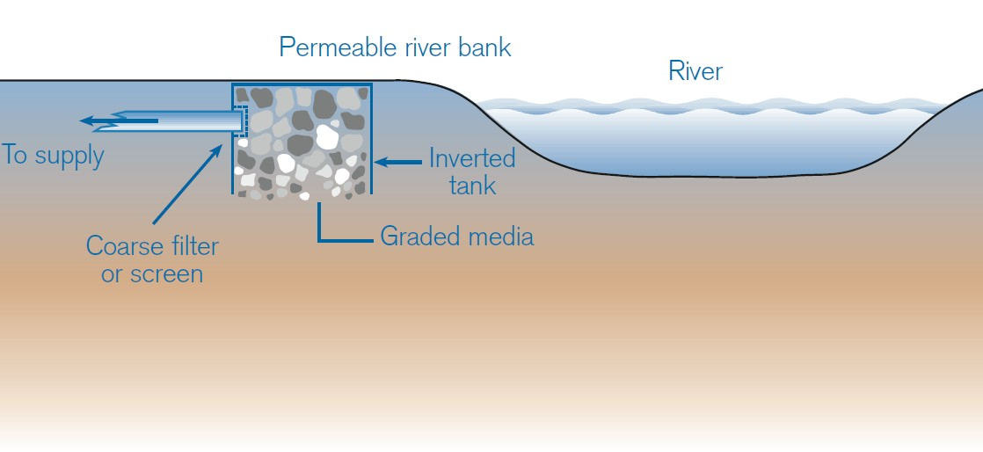
Overview – Surface Water

Slide 53
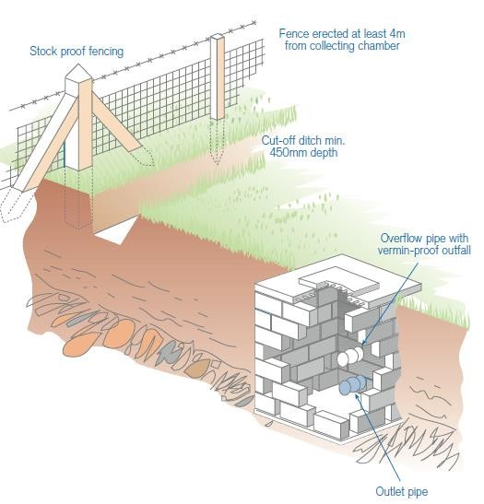
Overview – Surface Water Part 1

Slide 54
Overview – Surface Water Part 2

Slide 55
Overview – Surface Water Part 3

Slide 56
Questions Part 1
SSW1 | Is there a noticeable change in the quality of the water due to meterological conditions (colour, cloudiness/turbidity)? | Source water quality may be impacted by weather conditions such as high winds or heavy rainfall causing turbulence in the source water, disturbance of sediments and increased surface water run-off. Changes in levels and flows can result in deterioration of raw water quality with associated increases in turbidity and colour due to the suspension of sediment. This will be most prevalent during periods of heavy rainfall, when flooding and rapid runoff of surface water into the source can occur. Associated water treatment must be designed to meet the demands of these "flashy" conditions. | 4
SSW2 | Is freshwater aquaculture practised upstream, causing contamination (feed, pesticides etc.)? | Hazards associated with fish farms include pesticides, particulates from organics feed and waste material, including faecal matter. | 4
SSW3 | Is the source water used for recreational purposes? | Recreational water can become contaminated especially if there are boating activities as boats can discharge oil, lavatory waste or other chemicals into the water. The risk of contamination of a PWS by oil or fuel can be reduced by installation of a boom surrounding the intake point. | 4
SSW4 | Is the source water subject to seasonal algal blooms? | The main hazard associated with algae is filter blocking. However, some species of blue green algae produce toxins. This is a seasonal occurrence, therefore check with the person in control if they have experienced this at the supply. Assessment of the associated risk to public health is not straight forward. Such assessment should therefore take account of specialist advice such as "Blue -green algae (Cyanobacteria) in Inland Waters: Assessment and control of risks to public health". | 3
SSW5 | Could activities such as forestry, quarrying or construction create a risk to quality? | Forestry activities including fertiliser applications and felling can result in the release of nitrates and phosphates into water bodies through run-off. This can contribute to the eutrophication of surface water sources. Quarrying and construction activities have the potential to release sediment and suspended solids which can impact the quality of surface water sources by increasing turbidity levels. | 3
SSW6 | If the source is a spring, could surface water or spillages of contaminated material enter the supply because the headworks isn't fully sealed ? | If the chamber is not in a satisfactory state of repair, the lining is not watertight (i.e. where there is deterioration of the cement lining, brick, stone or concrete rings by roots or by other damage) or does not have a watertight cover, then there is a risk of ingress into the spring chamber causing potentially contaminated surface water to enter the supply. If there is evidence that the chamber is not watertight then the likelihood score should reflect the almost certain nature of the hazard. | 5
SSW7 | Is there a risk of debris or particulate matter entering the supply? | The intake from a river/lake/stream should be located away from any features that may cause turbulence and increase the disturbance of the source water. The design and construction of the spring/surface water collection chamber should be such so as to prevent vermin, debris or particulate matter entering the supply. The intake should enter through the base or side of a collection chamber through a coarse filter of natural material or purposely provided small stones/gravel/sand or the inlet pipe should be fitted with a strainer to prevent the ingress of fish, debris or vermin. | 3
SSW8 | Is there a risk of the intake becoming clogged? | Clogging of the intake may cause loss of supply due to blockage of strainers/ filters or pipe work. Note, frogs are often found in spring supplies and can clogg inlets/outlets and pipe work. The design and construction of the spring/surface water collection chamber should be such so as to prevent vermin, debris or particulate matter entering the supply. | 3

Slide 57
Overview - Groundwater
Boreholes

Slide 58
Overview – Groundwater Part 1
Wells

Slide 59
Overview – Groundwater Part 2

Slide 60
Questions Part 3
SGW1 | Are there any abandoned wells or observation boreholes in the vicinity of the source that could present a risk of aquifer contamination? | If there are unused supplies or wells associated with the supply under investigation then the potential for material to be introduced directly into the source water exists. For example, if an older, out of use well is located adjacent to the currently operational well, any contamination of the out of use well or borehole can affect the water source. | 4
SGW2 | Could livestock have access to the well head area ? | Look for any evidence of domestic livestock production being present either directly (by the presence of animals in the vicinity of the supply) or indirectly (through presence of broken ground around the supply or the presence of animal droppings around the supply). Risks can be increased where the source is in a high vulnerability area. | 5
SGW3 | Is there a risk of standing water/ponding within 50m of the headworks? | Look for evidence of standing water around the source, or evidence standing water has been present (marshy ground). This indicates the soil around the source is more likely to be saturated and therefore any flow of surface water into the source will be faster. Risks can be increased where the source is in a high vulnerability area. | 4
SGW4 | Is there a risk of ingress due to poor headworks design, construction or condition? E.g. lack of grouting, diversion ditches, concrete aprons,..... | Surface water or subsurface flows can contaminate the borehole/well where there is inappropriate or absent grouting or lining material. This can be protected against through the use of appropriately engineered borehole arrangements. The borehole needs to be protected from the ingress of surface flows (such as flooding). This can be accomplished in a variety of ways such as having a ditch surrounding the borehole with an impermeable lining and a suitable discharge downslope from the borehole conveying surface water away from the immediate vicinity of the borehole. It should be borne in mind that evidence of surface flows may not be present at the time the supply is visited, but could still be a risk under the right circumstances. The design and construction of the headworks needs to take this into account. | 5
SGW5 | Is there a risk of failure of the borehole pump due to lack of regular maintenance? | Without a record of when the borehole pump was installed and regular servicing of the pump then there is a risk of the pump failing and no water being available. This is more critical at sites where there is no storage of water. A maintenance and inspection programme should be in place. | 4
SGW6 | Is the ability to sample the water from each specific borehole inadequate? | Where the water supply comes from more than one groundwater source, it is important to be able to sample the individual sources. If there is an issue regarding contamination of the water supply, the investigation may require sampling of the individual sources to identify the source of the contamination. This would allow decisions to be taken regarding taking certain boreholes out of service. In addition, the ability to sample specific boreholes would allow the identification of any parameters that may need to be diluted through blending with other boreholes. | 3
SGW7 | Is there a risk of chemical contamination (e.g. hydrocarbons, pesticides, nitrates) either directly to the headworks or to the local groundwater? | Contamination can occur from a number of sources, including accidental spillage, intentional (but inappropriate) application in the area directly around the borehole, and more widespread contamination of ground water from diffuse pollution in the groundwater catchment area. In areas where the bedrock is fractured or highly permeable (such as limestone Karst), activities some considerable way from the borehole can have an impact on quality. Specialist geological advice may be needed. | 4

Slide 61
Tanks
Matt Bower
DWQR Risk Assessment Training 2018

Slide 62
Overview Tanks
Risk assessment covers raw and treated water tanks
RA can hold as many separate Tank RA’s as you need
Poorly designed / maintained tanks can be a significant risk to water quality
PWS grant can be used to improve tanks

Slide 63
Tanks - ideally

Slide 64
Tanks – ideally Part 2

Slide 65
PWS Tanks – ideally part 3

Slide 66
PWS Tanks – The majority

Slide 67
PWS Tanks – Key points
Structure
Material sound?
No cracks or gaps (insects / vermin access)
Material – appropriate for drinking water?
Tree roots
Access Points
Hatches sound and sealed
Air vents – mesh cover
Overflows – flaps / mesh
General
Turnover / stagnation
Solar heating
Sampling
Means to drain

Slide 68
PWS Tanks – Key points Part 2
Maintenance
Inspection
Structural repairs
Vegetation / animal holes
Hatches / vents
Seals / mesh intact
Internal inspection & cleaning
Decide on frequency (SW treated water once per 5 yrs)
Hygiene
Remember health and safety!

Slide 69
Questions on Tanks
DTK1 | Is there a risk of treated water reservoirs or tanks being constructed of unsuitable material? | Tanks should be constructed from materials that are appropriate for use with drinking water, and ideally are approved as such. Innappropriate materials can fail structurally, or leach substances into the water that can be harmful or give the water an unpleasant taste. Tanks that have previously been used for another purpose can contain residue from whatever was in them before, and this can contaminate the supply. | 4
DTK2 | Is there a risk of microbial contamination in the vicinity? | This is similar to microbial risks in general catchment. Consider both activities such as slurry spreading and storage such as septic tanks. Consider integrity of the tank structure and accessibility of inspection chambers. Inspection chambers must be adequately protected by fences that are of appropriate height, material and robustness. | 5
DTK3 | Is there a risk of chemical contamination in the vicinity? | This is similar to chemical risks in general catchment. Consider both activities such as pesticide/fertiliser use and storage of fuels/oils. Consider integrity of the tank structure and particularly the inspection chambers. | 4
DTK4 | Is there a risk of low turnover of water? | The size of the tank should be proportional to demand. Water which remains standing for any length of time in a holding structure will deteriorate to varying degrees depending on the conditions it is exposed to. The level of the water within the reservoir/tank should therefore rise and fall at intervals throughout each day, facilitating the constant input of fresh water to the structure. As a guide in raw water storage tanks, the water should be turned over (replenished due to use) every 7 days to avoid taste and odour issues and microbial or biofilm growth. Ask the owner to what extent the water is used on a daily basis and whether the capacity matches the demand, i.e. if the tank is too small then there may be a risk of insufficiency or if the tank is too large water may stand for long periods due to low demand. | 4
DTK5 | Is there a risk of excessive solar heating of water? | The tank should be designed to avoid excessive heating of water that could encourage microbiological activity. Metal or dark coloured tanks that are above ground can be particularly vulnerable to this. | 4
DTK6 | Is there a risk of ingress of microbiological or chemical contamination, including rain or surface water through covers or tank structure? | Structural cracks and other defects in the roof and sides of the reservoir/tank provide a route of contamination, notably microbiological, via water ingress/rain. The reservoir/tank should be in a good general state of repair. Inspect its condition, looking for points of ingress and weakness, paying particular attention to the roof condition, and areas of notable deterioration or decay, which pose a future risk should the structure come under stress. Where possible, carry out internal inspections to determine any points of ingress or potential points of ingress. Flooding the roof during inspections will highlight areas requiring remediation. Any reports from contracted inspections should be consulted to assist with the assessment. | 5

Slide 70
Questions on Tanks Part 2
DTK7 | Is the integrity of the reservoir suitably robust against damage by weather or animals? | The overall structure of the reservoir should be fit for purpose at all times to ensure any risk to its integrity is not compromised. Consider its position and robustness (including the material it is made of) in terms of its exposure to adverse weather in a worse case scenario and livestock within its vicinity. | 4
DTK8 | Are there any unprotected or inadequately protected access covers, overflows and/or vents? | Access covers, overflows and air vents present potential routes of ingress of water and other materials, which pose a risk of microbiological contamination and poor aesthetic quality. Vents and overflows should be checked to ensure adequate protective mesh is in place to prevent access of vermin and other wildlife, and ingress of general debris (leaves, insects, soil etc). Entry/access covers should be of a robust material, watertight and in a state of good general repair. There should be seals around the opening to the reservoir/tank that are in a sound state of repair (i.e. not in a state of decay, absent or do not provide an adequate seal against ingress). | 4
DTK9 | Is there a risk of vandalism of storage tanks? | Tanks should be adequately protected against the risk of intentional damage. Covers and access points must be securely locked when not in use and access to these points controlled. Check that the owner has records of all key owners. The reservoir/tank should be suitably robust in structure in a secure location. | 3
DTK10 | Is there a risk of deliberate contamination of treated water and unauthorised access? | Reservoirs should be adequately protected against the risk of intentional damage. Covers and access points must be securely locked when not in use and access to these points controlled. Check that the owner has records of all key owners. The reservoir/tank should be suitably robust in structure in a secure location. All tanks must be insulated against solar heat gain or freezing. Inspection chambers must be adequately protected by fences that are of appropriate height, material and robustness. | 4
DTK11 | Is there a risk from lack of regular maintainance and cleaning (with appropriate records)? | Verbal assurance from the owner that a reservoir is regularly cleaned/maintained is not evidence in itself that the action is undertaken or that the frequency is appropriate. Examine any available records, such as log books and/or supporting documentation such as contractual work receipts as evidence. In addition, look for physical signs that covers and access points are in regular use for this purpose. Annual cleaning is recommended for a surface water supply and frequency for other sources should be determined as appropriate, based on water quality history and the current risk assessment. Note that this question is not applicable to temporary installations/events. | 4
DTK12 | Could it be difficult to obtain a representative sample of stored water? | Tanks are often difficult to obtain representative samples from. Ideally access should be good or a tap identified that is close to the outlet of the tank. | 3

Slide 71
Creating a Risk Assessment
Matt Bower
DWQR Risk Assessment Training 2018

Slide 72
Overview of RA Tool Risk Assessment

Slide 73
Provide likelihood score (1-5) Severity already populated

Slide 74
Treatment – Plant Design
Matt Bower
DWQR Risk Assessment Training 2018

Slide 75
Process Design
Take a step back – see the big picture
Consider raw water quality
Is there enough information?
Emerging risks
What is water used for?
Where does the water need to go?

Slide 76
Process Design Part 2
Ask Yourself a Few Questions
How would I design the treatment process from scratch?
Is everything that is here necessary?
Is there anything here that isn’t needed?
Is it dealing with all water quality issues
Regulated and unregulated (Crypto)
What could go wrong?
Where does the water need to go?

Slide 77
Capacity & Flow
What is the max water flow through the process?
Is flow measured anywhere?
Some process are sized for a certain flow
UV
Chemical filters
Is there a flow “pinch point”?
How variable is the flow?
Can the process cope with that (chemical dosing needs to adjust)
Is the process reliant on blending out contaminants?
This needs to be controlled and monitored

Slide 78
Quality
How is it being monitored?
How does it change over time?
Some processes need stable quality; others will only work within certain parameters
Some parameters / process need regular checks
Chemical dosing
Chemical filters

Slide 79
Installation
Stuff only works when it is fitted correctly……
Follow the process - does it look logical to you?
Competent installer?
In line with manufacturers’ specifications / guidance?
Should be installed with maintenance in mind
Pitfalls – Bypasses, Short-circuiting, Contamination

Slide 80
Records and Information
Ideally…..
A schematic diagram of whole treatment process
Operating manual for each process
Required maintenance
Parts
Chemical specifications
Validation information / certification
We’ll come back to this subject in MANAGEMENT CONTROL……..

Slide 81
Records and Information Part 2

Slide 82
Questions on Treatment Part 1
TPD1 | Is the treatment process layout inadequately documented? | A treatment plan or schematic should be available, this can be a simple sketch or a more complex and detailed drawing depending on the scale of the treatment. This should at least include locations of the incoming water flow, direction of flow, bypass points, dosing points, treatment type and points, monitor locations, out flow, etc. and materials. It need not be to scale but should represent the main treatment of the supply. | 5
TPD2 | Has there been inadequate consideration of Cryptosporidium in design of treatment? | Cryptosporidium is found in faecal matter from livestock and wildlife and in sewage. It can affect any surface water sources or vulnerable ground water sources influenced by surface water. A multi-barrier approach is recommended to remove Cryptosporidium from supplies; coagulation, clarification and filtration for example. Chlorination is not effective against Cryptosporidium, however, UV treatment will inactivate it. | 5
TPD3 | Is the treatment plant operating outside its design capacity? | For any treatment process, there are operational limits beyond which treatment performance diminishes. The quality of the drinking water being produced may be adversely affected if this occurs. Therefore any process being used beyond its designed capacity or specification requires action to be taken. Refer to any available information provided by the manufacturer on the design specification for the treatment and criteria on which the treatment process was designed. Check whether the 'demand' on the supply has significantly increased since the plant was designed and built, e.g. from additional commercial premises, large numbers of additional houses. Check the volume of water being treated and the type of treatment process. Flows greater than design capacity will compromise water quality, e.g. due to insufficient contact time with UV or overloading of filters. | 5
TPD4 | Is there a lack of knowledge and documentation on the treatment plant design / capability / capacity? | It is essential to have a knowledge of the treatment so that any problems can be identified and appropriate mitigation action taken. If an understanding of the treatment of the supply is not demonstrated and no maintenance contract is in place, then the likelihood should be scored as 5. Manuals or manufacturer's instructions for the treatment should be available at the site. | 5
TPD5 | Is it possible to by-pass any stage of treatment? | Check for pipe work and/or valves that by-pass any treatment stage. If a UV lamp can be easily switched off (e.g. to save electricity) this is bypassing a treatment stage. | 5

Slide 83
Questions on Treatment Part 2
TPD5 | Is it possible to by-pass any stage of treatment? | Check for pipe work and/or valves that by-pass any treatment stage. If a UV lamp can be easily switched off (e.g. to save electricity) this is bypassing a treatment stage. | 5
TPD6 | Where there is a blending facility, is the blending strategy inappropriate? | Blending can be the mixing of a public water supply with a private supply or between multiple private water sources. This may be carried out to meet water quality standards. Assessment of the blending strategy requires interpretation of sample results and knowledge of seasonal variations, e.g. of boron, arsenic, fluoride and nitrates. Check that procedures are in place for the calculation and management of the blending ratio. I.e. are the sources being blended in the correct quantities to meet the criteria defined in procedures to eliminate exceedances of the standards? Does the strategy take into account seasonal variations? | 4
TPD7 | Are there frequent flow/demand variations through the treatment plant, which render the treatment process inadequate in terms of either sufficiency or quality? | Variations in flow rates can cause low pressure, insufficient or loss of supply to properties. Flow variations may also compromise water quality by affecting coagulation, clarification, filtration and disinfection treatment processes, particularly when sudden changes occur. Changes to flow rates should therefore be made gradually and should not exceed the design capacity of any individual treatment process. | 4
TPD8 | Are there large raw water quality variations, which could exceed the design capability of the treatment process ? | Some treatment processes struggle to cope with rapid changes in the quality of the water they are required to treat. If this is the case it may be necessary to install pre-treatment or storage in order to ensure a more consistent quality of water entering the main treatment process. | 4
TPD9 | Does / could inadequate installation cause quality problems? | Potentially effective treatment processes can be rendered less effective by innappropriate installation, in terms of siting and the way in which they are connected or commissioned. Check for obvious issues such as short circuiting and post-treatment contamination. Treatment equipment should come with detailed installation instructions and / or be fitted by a trained person. | 5

Slide 84
Treatment – Process Resilience
Matt Bower
DWQR Risk Assessment Training 2018

Slide 85
Treatment Process Resilience
A bit of a “Catch all” section relating to the ability of treatment to operate under all situations and the ability to pick up issues if they occur
Chemical contamination
Severe weather
Third party interference
Power issues
Testing and monitoring
Emergency planning

Slide 86
Treatment Process Resilience Part 1
Chemicals
Wrong chemical
Unapproved / inappropriate for drinking water
Out of date
Incorrectly stored
Incorrect use of chemical
Wrong dose
Added in wrong place
Added to wrong storage vessel
Chemical contamination

Slide 87
Treatment Process Resilience Part 2
Weather
Affecting Treatment Process
Freezing
Access to site
Power Supply
Complete failure
Inadequate / no back-up power
Process fails to restart when restored

Slide 88
Treatment Process Resilience Part 3
Monitoring
Sufficent
Onsite testing
Online monitors
Alarms
Maintained
Third Party
Vandalism
Interference
Inadvertent contamination

Slide 89
Treatment Process Resilience Part 4
Emergency Plan
Event | Location | Action to be taken | Comments
Source blocks
Source water quality deteriorates significantly
Raw water pipe bursts
Power to water treatment fails
Filtration Process Stops stops producing water
Arsenic concentrations rise above 10ug/l PCV
Distribution pipe bursts
Water samples contain bacteria
Water becomes discoloured
Add events here as necessary

Slide 90
Questions on Resilience Part 1
TPR1 | Is there a risk of chemicals used for water treatment being unapproved or out of date? | Check all chemicals being used on site are approved for drinking water use and that they are within their expiry dates. | 5
TPR2 | Could chemicals be added to the wrong storage vessel? | Check how chemical deliveries are made and ensure there are controls in place to avoid mix up of chemicals, e.g. check dosing points are unique and labelled, chemical deliveries are always accompanied by competent person, an approved chemical deliverer is employed, or that a chemical specification sheet accompanies any delivery. | 4
TPR3 | Could adverse weather conditions render the treatment process and/or chemicals ineffective? | Cold weather can cause dosing lines to freeze and have a direct adverse impact on the efficacy of treatment processes. Pipes should be lagged where appropriate and equipment protected from frost/freezing. During periods of cold weather treatment processes should be checked and there should be adequate contingency procedures should pipes or processes fail. | 5
TPR4 | Could stored chemicals or oil cause contamination due to inadequate bunding? | Chemical storage should be contained in a bunded area sufficient to hold all the chemical compound in the event of a burst container. Check there are no drain holes in the bunding and that the containment area is not liable to fill with rain water. This can be a robust solid crate or tub if large enough. Any fuels / oil should be stored well away from treatmnet chemicals. | 4
TPR5 | Is there a risk of chemical injection point(s) being damaged, for example by frost? | Ask for evidence as to how any dosing point is protected from extremes of weather or physical damage. | 5
TPR6 | Is there a risk of treatment not being re-established after any loss of power supply? | Check there is an adequate procedure in place to restart treatment processes after loss of power, including checks of individual processes to ensure they are working within specification. Some processes such as biological filters may require a period of run to waste. | 5
TPR7 | Is there a risk of any power back-up or alternative power supply being inadequate? | Does the site have a back up generator that is sufficient to power up all the critical treatment processes? Where an alternate power supply is not present; what contingency is in place for the provision of alternate supplies of drinking water? | 5
TPR8 | Is there a risk of vandalism? | Treatment processes should be in secure buildings. Check perimeter fencing, access gates and the control of the use of any security keys. | 5
TPR9 | Is the site/access to site liable to flooding which would result in loss or restriction of treatment process? | Gauge from surrounding topography if the site is at risk of flooding. Ask the person in control if the site has been flooded in the past. Gauge from topography and access routes if the site could become isolated during adverse weather. Ask the person in control if the site has been isolated in adverse weather conditions such as flooding or heavy snow. Lack of access during these times may mean essential water quality checks can not be made, or that chemicals stocks can not be replenished. For sites where access is difficult during periods of adverse weather there should be adequate procedures to manage stocks of treatment chemicals and communication with consumers should boil water advice be necessary. | 5
TPR10 | Is quality monitoring of the treatment process inadequate? | On-line monitors should be appropriate to any treatment processes present. Where filtration is practised or UV treatment is in place, turbidity monitors allow the operators to check that filtration is effective in reducing the turbidity levels, so that water presented for disinfection is below 1 NTU. In areas with naturally coloured water, transmissivity / colour / TOC monitors may be appropriate to ensure UV will be effective. If the supply is chlorinated, a chlorine monitor will ensure that the supply is maintaining the effective chlorine dose for disinfection. If appropriate manual checks are not carried out (with appropriate documentation), on-line monitors or an equivalent system should be used. | 5

Slide 91
Questions on Resilience Part 2
TPR11 | Is there a risk that process issues go undetected due to lack of alarms? | This should be proportionate to the size of the supply. One with two or three domestic dwellings may not require alarms, but a supply with several properties including commercial premises should have alarms on the monitors. If they do, are the trigger levels appropriate? Turbidity on filtered water should alarm at 1NTU as above this any subsequent UV treatment will not be fully effective. UV will also be compromised if the transmissivity of the water falls below a certain level (should be documented with installation). An alarm for UV failure may be particularly appropriate as the loss of disinfection is immediate when the UV is off. If chlorine disinfection is practised, the operator should specify triggers for low or high dose which should alarm if breached to alert them to the fact that either the water is not being adequately disinfected, or that water is being supplied with high levels of chlorine, which may be unacceptable to the consumer. Check what action is taken if the alarm is triggered - is the response time appropriate and is there evidence the procedures are being adhered to? Is there an auto shutdown of the supply if disinfection fails? An auto shut down would be appropriate if no one could hear the alarm and it could not be acted on. | 5
TPR12 | Is there a risk that any monitors are not correctly calibrated and maintained? | Most on-line monitors require regular calibration and occasional maintenance to ensure their measurements are accurate and the person in control of the supply can be assured that the process is operating within specification. The manufacturers should specify the frequency, but as a rule calibration with standards should be at least monthly. If this is carried out through a service agreement with the installer or other contractor, then you should confirm that the number of visits is appropriate and there is evidence the service agreement is being adhered to. | 3
TPR13 | Is there a risk of inadequate / incorrect onsite water quality testing ? | On-site testing kits are available for many water quality parameters, and they can be useful for checking quality and verifying that processes are working. Sometimes, such tests may not be as reliable as on-line monitoring and laboratory analysed samples, especially if they are not used in strict accordance with manufacturers' instructions. Sometimes misleading results can be obtained which can give a false sense of security that treatment processes are working (or that there is an issue that doesnt exist). Any test reagents should be correct and in date. | 3
TPR14 | Is there an inadequate emergency plan in place should treatment fail, especially for disinfection treatment? | If water treatment processes fail, the water may not be safe to drink. It is vital that users are made aware of this as soon as possible and contingency arrangements made. Having an up to date emergency plan that all who manage and use the supply are aware of is highly recommended, and should be in place prior to any issue occurring. | 3

Slide 92
Control Measures
Add control measures: What is in place to reduce the risk?
Hopefully treatment!

Slide 93
Control Measures Part 2
Add validation:
How do we know the control is in place?
“Evidence that the control is appropriate to the risk and capable of being effective”

Slide 94
Control Measures Part 3
Add verification:
How do we know the control is still working?
“Routine, ongoing confirmation that the mitigation is continuing to be effective”

Slide 95
Control Measures Part 4
Re-score likelihood:
What is the new likelihood with the controls in place?
Score should be lower but could be unchanged if control not considered effective

Slide 96
Creating a Risk Assessment

Slide 97
Creating a Risk Assessment 1

Slide 98
Creating a Risk Assessment 2

Slide 99
Creating a Risk Assessment 3

Slide 100
Creating a Risk Assessment 4
Can export questions here
Answered questions change colour
Don’t need to answer questions that you consider completely irrelevant. Suggest using sparingly – even if risk very low may be worth including to ensure risk is noted.

Slide 101
Creating a Risk Assessment 5

Slide 102
Creating a Risk Assessment 6

Slide 103
Creating a Risk Assessment 7

Slide 104
Creating a Risk Assessment 8
Scope to provide additional info or add completely new item. Item does not get added to future drop down list.

Slide 105
Creating a Risk Assessment 9
Re-score likelihood using same criteria but considering effect of any mitigations. In this case the relationship with the quarry and fact that there’s treatment halves the risk.
Navigate back to list of Ques

Slide 106
Creating a Risk Assessment 10
Click once RA finished
This will complete the RA

Slide 107
Creating a Risk Assessment 11
This RA is now closed. It can be
viewed or cloned so that you
don’t have to start from scratch to review it.

Slide 108
Creating a Risk Assessment 12
Clicking here will create a brand new (blank) RA for the PWS.
This RA is now closed. It can be
viewed or cloned so that you
don’t have to start from scratch to review it. Can only clone latest version.

Slide 109
Treatment – Distribution Pipework
Matt Bower
DWQR Risk Assessment Training 2018

Slide 110
Overview of risk
Large area of risk
Wide range of materials and conditions
About management and filling in knowledge
gaps
Often neglected part of the system
Much is down to owners and users…..

Slide 111
Pipework – What can you risk assess?
Pipe bridges Surface mains Air valves
Hydrants / valves / wash outs Water quality

Slide 112
Pipework – Key Points to Watch For
Main contamination risks
Pipe integrity
Air valves
Backsiphonage (suck back…)
Hydrocarbons
This will permeate plastic pipes
Inappropriate pipe materials
Lead, plastics, Coal tar linings
Other issues
Long residence times
Dead legs
Third party access
Freezing
Disinfection by-products
Mainly where chlorine or chlorine dioxide used

Slide 113
Questions
DPW1 | Is there a lack of understanding of the location and direction of flow of water in distribution? | There should be a clear site plan or schematic with the location (and direction of flow) of the drinking water, greywater or sewage pipes. There should be clear labelling and pipe specification for the different systems - full details in BS 8515 and WRAS guidance Note 9-02-05. Main water connections to any private water supply must be protected from cross- connection and backflow protection is required on the mains supply. | 5
DPW2 | Is there a risk of a deterioration in water quality after treatment, so that it is not fully compliant with quality standards? | This can be determined by the examination of sample results, either taken during the risk assessment, during previous risk assessments or through other monitoring arrangements, e.g. WFD ground water monitoring surveys, on-site tests. If results indicate that the water is not compliant with quality standards, the control measure(s) must be appropriate to the cause, as indicated by the results, and may require revision of the treatment. | 5
DPW3 | Is there a risk of microbiological contamination (latrines, septic tanks, waste pipes, animal enclosures or cess pits) present in the vicinity of the distribution system? | If unsewered human or animal sanitation is present within 50m of the distribution system then there is potential for raw human sewage to contaminate the distribution network if there are any defects. Consider any available information on the positioning of septic tanks as well as their condition (maintenance), as well as any available information on the soakaway location in relation to the distribution network. | 5
DPW4 | Is there evidence of disinfection by- products in the network (e.g. taste problems due to THMs)? | There are many different disinfection by-products but those most commonly analysed for are Trihalomethanes (THMs) which are usually identified through sample results. In certain circumstances they may cause taste/odour complaints. This will only be applicable in a Private Distribution system if there is additional treatment after the point of supply and where chloramination or chlorination is present, and such an arrangement should be checked. | 4
DPW5 | If chlorine/chlorine dioxide disinfection is practised is there a risk of low disinfectant residual in the distribution network? | Chlorine dioxide residuals should be set according to the specific circumstances of the supply system. A target resdual should be set and monitored for at the end of the distribution system; This should be monitored regularly. Too high a residual could lead to byproduct (chlorate) formation. | 3
DPW6 | Is there a risk due to no process for mains repair and maintenance? | This relates to the existence of a procedure and how well it ensures protection against contamination, i.e. hygienic Installation and Operations (repairs being carried in a clean environment, fittings disinfected before use, etc.). If no, the likelihood score relates to the frequency of mains repair or other maintenance. | 5
DPW7 | Is there history of any fractures or faults in the distribution system which could allow ingress of contamination? | A history of fractures or faults (burst pipes, loss of supplies) could indicate that the pipework is in an unsatisfactory condition or is vulnerable to damage. In a pumped supply this may indicate a lack of pressure control resulting in leaking pipes. | 4
DPW8 | Is there any other route by which contamination can enter the distribution network via back-flow? (air valves, cross connections, dead legs of pipe) | Contamination can also enter the distribution network via back-flow. This comprises back pressure (pushed) or back- siphonage (sucked). Where pressure differentials occur without suitable back-flow or air gap protection then contamination may enter the network through cross connections; leaking joints, broken pipes etc. | 4

Slide 114
Risk Assessment – Getting Information Out
Matt Bower
DWQR Risk Assessment Training 2018

Slide 115
Risk Assessment – Getting Stuff Out
Once RA is closed it can be
exported (not before)

Slide 116
Risk Assessment – Getting Stuff Out Part 2

Slide 117
Risk Assessment – Getting Stuff Out Part 3

Slide 118
Information Export Simple Water Safety Plan
Exports static information based on risks identified at specific locations on PWS system
Broken down by hazard type
Aimed at domestic premises
Provides simple, easily understood advice on one sheet for those with limited technical background
Exported as Excel doc to enable editing and pasting into preferred LA format

Slide 119
Risk Assessment – Getting Stuff Out Part 4

Slide 120
Information Export Full Water Safety Plan
Exports full DWSP template with main risks and controls documented
Can be tailored by user to individual property
Aimed at more complex, regulated supplies who should have some
technical knowledge
LA can set risk minimum score to be exported
Includes blank templates to be completed – Summary of actions, responsibilities, and emergency
Exported as Excel doc to enable editing and pasting into preferred LA format

Slide 121
Information Export Full Water Safety Plan Part 1

Slide 122
Information Export Full Water Safety Plan Part 2
Control Measures (Mitigations)
Control Measures (Mitigations)
Operators have a good understanding of the process
Regular maintenance reduces risk
Training of operators
Other
Clear labelling
Stock control of spare filters
Documented instructions
Stock control system
Evidence that UV is effective
Point of Use Treatment
Control Measures (Mitigations) - Additional
Information
Sizing of filters is documented and spare stock kept,
plus good labelling
Mitigated Risk Score
Highest mitigated risk score: 25 (Excessive)

Slide 123
Questions Assessment
DPW 9 | Is there evidence any pipes are coal tar lined (could cause PAH failures)? | Coal tar was used pre-1970 to line iron mains. Coal-tar linings can be discounted in plastic, cement mains or asbestos mains. This material contains compounds, amongst others, called polycyclic aromatic hydrocarbons, some of which are known to be carcinogenic above certain concentrations (consult WHO guidelines). Furthermore, coal tar lining can cause various unpleasant aesthetic issues, including petrochemical like taste and odours. | 4
DPW 10 | Do any third parties have access to hydrants or other points in the distribution system? | Third parties (contractors, builders, tenant farmers etc.) should only have access to hydrants via a procedure of authorised permission to operate them. This should only be granted where risk of disturbing deposits has been assessed as low. Where no such system is in place, an appropriate procedure must be implemented which should include control of their use. | 5
DPW 11 | Is there a risk of chemical contamination of pipes (e.g. from contaminated land, oil from generators/ household fuel tanks/ fuel stores or solvent spillage)? | Oil and other hydrocarbons can pass rapidly through plastic pipes and contaminate the water; This can be a particular problem with petrol / diesel spills on driveways or sills of heating oil. Historic contamination in soils can also affect plastic pipes. In these circumstances metal or "barrier" pipe can be used. | 4
DPW 12 | Are there any pipes exposed and at risk of damage by any means, e.g. vermin, vehicle, UV/sunlight damage, overheating or freezing? | Pipes that are laid overground or in shallow trenches may be at risk of damage by gnawing rodents, or accidental damage by other wildlife or livestock or any other means, including those caused by motorised vehicles or machinery. Consider this risk in terms of the pipe material, their position, location, exposure to vermin and other animals, use of surroundings. Freezing or overheating may also occur. | 4
DPW 13 | Is there a risk to quality from a lack of control over valves in the network which are normally closed? | Closed valves require periodic Installation and Operation to prevent them seizing up? However, deposits do collect behind them over time and can cause discolouration and turbidity. Therefore such Installation and Operations must be controlled by an approval procedure, to ensure valve Installation and Operations are first risk accessed and only carried out by competent persons following an appropriate procedure. | 3
DPW 14 | Are there, or could there be, sections of pipework containing stagnant water? | These are characterised either by sections of mains of a relatively large diameter in relation to the demand off these, e.g. a 3" main with a trough at the end which is only occasionally used is likely to contain stagnant water; or legs of main with no connections off these and therefore no turnover of water; or where a low discharge point is present? (i.e. a single standpipe). 'Dead legs' of main may be present | 3
DPW 15 | Where there is copper pipework present, is it corroding? | Where copper pipes are used in the distribution system, these problems can be determined through on-site tests, or may manifest in taste complaints (metallic) or discolouration (blue/green) or laboratory tests. | 3
DPW 16 | Are lead pipes / fittings present in the supply? | Lead pipes are usually only found in distribution systems laid before the 1970s. Unpainted lead pipes appear dull grey. They are also soft and if they are gently scraped you will see the shiny, silver-coloured metal beneath. Dissolution of lead into the water supply occurs at a higher rate where the pH of the water is lower (more acidic). | 4
DPW 17 | Have there been complaints or reports of water quality problems (e.g. taste, odours or reports of any aquatic animals (freshwater shrimp, louse or worms)? | Ask the operator if there have been any complaints about the water being supplied or if there have been any known taste, odour or aquatic animal issues. When surface water is treated the majority of these plants and animals are removed. However, some animals and algae can pass through water filters and enter the distribution system. | 3
DPW 18 | Is the backflow protection within the distribution network inadequate? | If the premises are within the private supply, check whether backflow protection is in place. If the supply is a private distribution system (PDS), the appropriate Water Company can confirm whether any existing backflow deficiencies have been identifed upstream of the supply to the PDS. All private supplies should follow this best practice with backflow- prevention devices being installed. | 5

Slide 124
Management and Control
Matt Bower
DWQR Risk Assessment Training 2018

Slide 125
Overview of Management
Arguably most important part of RA
Single risk score required, with subsidiary questions to help you decide
It’s all about confidence….

Slide 126
Property – Property Specific Treatment
Matt Bower
DWQR Risk Assessment Training 2018

Slide 127
Overview of Management in the Property
Fairly common – treats whole house or only single
tap in property (POE / POU)
“Under sink solution”
Often cartridge filter, UV, but could be ion exchange or RO membrane
Property Specific Treatment section plus select as many individual treatment modules as you need

Slide 128
Property Specific Treatment

Slide 129
Property Specific Treatment Part 2

Slide 130
Property Specific Treatment – Things to Watch For
Inappropriate locations & installation
Bad DIY solutions
No maintenance
Drinking softened / RO water directly (not healthy!)
Other taps used for consumption in property not treated

Slide 131
Property – Internal Risk Assessment
Matt Bower
DWQR Risk Assessment Training 2018

Slide 132
Property – Internal Overview
We know it’s difficult
Important element in managing WQ
Some risks are enhanced on PWS
Various ways of approaching task
Gradually build up a picture - prioritise

Slide 133
Property – Internal Main Risks
Tanks
Lead piping & solder
Some (legal) brass fittings contain lead
Pipework design
Long runs
Dead legs
Tap hygiene
Cross connections

Slide 134
Property – Internal References
World Health Organisation – authoritative but aimed at larger premises
Anglian Water – practical guide in form of short videos around house

Slide 135
Property – Internal Risk Questions

